Slide 1
Hospital-acquired Infection
Infectious Diseases Elective

Slide 2
Overview
Definitions of hospital-acquired
Isolation precautions
HAP/VAP
CAUTI
C. difficile
MRSA bacteremia

Slide 3
Hospital Acquired Infections
Infections that occur while receiving care in a health-care facility (hospital, dialysis, ambulatory surgery or long-term care center)
Usually defined as onset > 48 hours after admit
1/20 hospitalized patients can develop an infection -> high associated cost
  An estimated 65-70% of catheter-associated bloodstream and urinary tract infections, VAP & surgical site infections are preventable

Slide 4
Infection Prevention
Isolation Precautions
Type | Indication | What? | Disease Examples
Standard | all patients | Hand Hygeine: soap + water x >15 sec or alcohol-based hand rub | all
Contact | organisms transmitted by direct or indirect contact | private room, gown + gloves | MDR organisms, C. diff, rotavirus, COVID-19, Monkeypox
Droplet | organisms transmitted from resp tract w/large droplets (>5 microns = go < 3 ft from patient) | private room, surgical mask for provider + patient when out of room | Influenza, COVID-19, N. meningitidis <24 hrs on antibiotics
Airborne | Organisms transmitted from small droplets (<5 microns = can travel > 3 ft from patient | Negative pressure room, N95 masks/PAPRs (patient must wear surg mask when out of room) | TB, varicella, measles, Monkeypox, COVID-19 (if aerosol generated procedure)

Slide 5
Hap/VAP

Slide 6
Diagnosis
Temp > 38°C, leukocytosis/leukopenia, purulent sputum, hypoxia with new lung infiltrates in a hospitalized patient
  Mechanical ventilation is the most significant risk factor for pneumonia in a hospitalized patient

Slide 7
2016 IDSA/ATS HAP/VAP Guidelines
Changes:
  Removed “HCAP” (the concept of healthcare-associated pneumonia)
  In effort to minimize patient harm and exposure to unnecessary antibiotic and reduce development of antimicrobial resistance recommend antibiogram data be used to decrease unnecessary use of dual GN therapy and guide empiric MRSA therapy

Slide 8
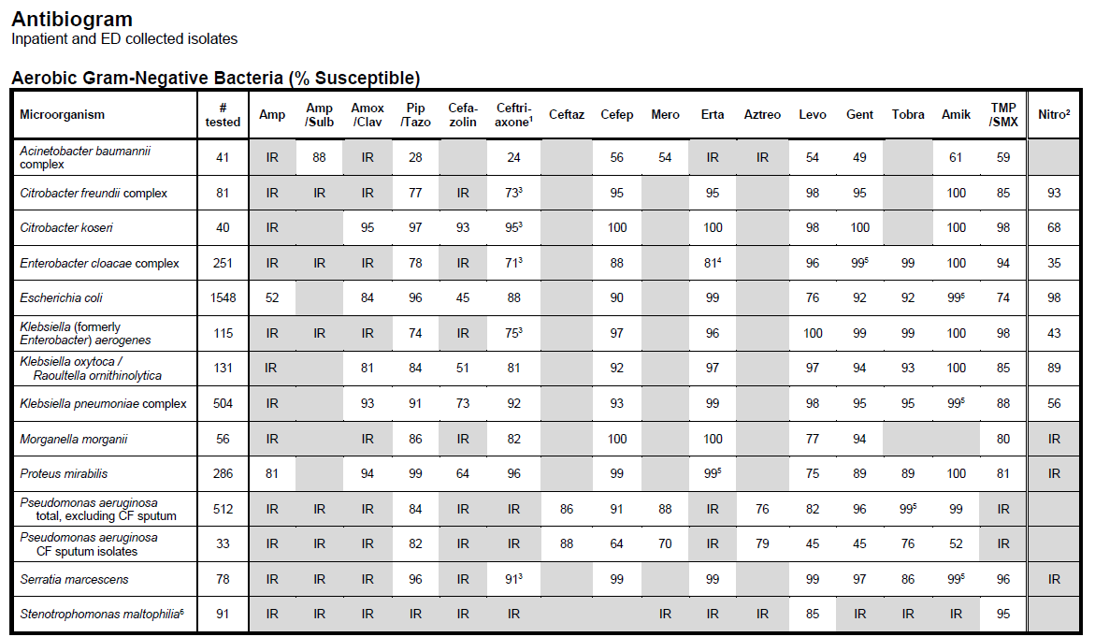
Example
Antibiograms will include:
# tested isolates
% susceptible
Indicate inherent resistance
Allow comparisons across drugs/years for monitoring resistance

Slide 9
Culture/diagnosis
Suggest non-invasive semi-quantitative cultures to diagnose (tracheal aspirate rather than BAL or mini-BAL)
Recommend clinical criteria alone (not procalcitonin, clinical pulmonary infection score, or other lab markers) to decide on starting antibiotics

Slide 10
HAP
Empiric therapy: coverage for S. aureus, PSAE/GN bacilli in all regimens
  MRSA coverage (vanc or linezolid) if: prior IV antibx use within 90 days, if treated in a unit with > 20% of S. aureus isolates are methicillin-R or not known, or high risk for mortality
  2 PSAE drugs from different classes if: prior IV antibiotic use within 90 days, high risk for mortality (narrow to monotherapy)
  Avoid aminoglycosides/colistin if alternative available

Slide 11
VAP
Empiric therapy: coverage for S. aureus, PSAE/GN bacilli in all regimens
  MRSA coverage (vanc or linezolid) if: prior IV antibiotic use within 90 days, septic shock, ARDS, >5 days hospitalization, acute RRT at time of onset, if patient treated in a unit with > 10-20% of S. aureus isolates being methicillin-R (or not known)
  2 PSAE drugs from different classes if: above risks and if in unit where >10% of PSAE isolates are resistant to the drug being considered for monotherapy
  Avoid aminoglycosides/colistin if alternative available

Slide 12
VAP/HAP
If pneumonia with organism resistant to all but aminoglycosides/polymyxins (colistin) recommend IV + inhaled therapy
Treatment duration 7 days
  Adjust depending on rate of improvement of clinical/radiographic/laboratory parameters
  Therapy should be de-escalated as able
  Procalcitonin to help de-escalate

Slide 13
Prevention
Sterilize/maintain respiratory equipment
NIV if feasible as alternative to intubation
HOB > 30-45 degrees
Daily oral care
Daily interruption of sedation to assess readiness for extubation using spontaneous breathing trials
Subglottic suctioning
*VAP prevention “bundles” improve outcomes

Slide 14
CAUTI
Catheter-associated urinary tract infection
  Largest proportion (40%) of HAIs
  Duration of catheter is directly proportional to the risk of CAUTI and often placed for inappropriate indications
  Pathogens: E. coli, Enterococcus, Pseudomonas aeruginosa, Klebsiella spp, *Candida albicans
* Candiduria = remove or change catheter, rarely requires treatment

Slide 15
Prevention OF CAUTI
Avoid catheters if feasible (consider alternates to measuring I/O, emptying bladder or dealing with incontinence)
Insert with aseptic techniques/sterile equipment
Assess daily need for continued catheter
Closed drainage system (no culture from open system), keep bag below level of bladder
No prophylactic antibiotics

Slide 16
CAUTI
Diagnosis: in setting of workup for fever, leukocytosis or other signs/symptoms of systemic infection in hospitalized patient with urinary catheter:
  Pyuria + bacteriuria (send culture and susceptibility only if symptoms + pyuria)
    ≥10³ CFU uropathogenic bacteria
Pyuria and/or bacteriuria are common in setting of catheters and routine UA/UC is not indicated if no symptoms or signs of systemic infection

Slide 17
Treatment
Remove or change catheter
7-10 days of directed antibiotic therapy, de-escalate as feasible

Slide 18
CLABSI
CLABSI (central-line associated blood stream infection) = clinical definition
  Catheter-related blood stream infection (Patient safety definition) -> may overestimate clinical cases
~250,000/yr, inc length of stay, 35% mortality
Consider if:
  Hospitalized patient with new fever, sepsis in setting of central-line (for at least 2 days) and no obvious sign or symptom of alternate infection
Diagnosis: at least 2 sets BCs (1 peripheral) taken before antibiotic therapy

Slide 19
CLABSI Prevention
Assess need for catheter prior to placement and daily
Placement with sterile technique (care bundle)
Subclavian>IJ>femoral site
Use fewest lumens as necessary (also helps prevent cath-related DVT)
Minimum weekly IV-line (dressing) care

Slide 20
CLABSI
Suspected if bacteremia found without another obvious source for secondary bacteremia
Common pathogens: S. epidermidis, S. aureus, Enterococcus spp., Candida spp., K. pneumoniae, Pseudomonas
Treatment: remove line
  Antibiotic therapy: 5-14 days directed intravenous antibiotic depending on pathogen
  For guidelines: see IDSA

Slide 21
S. aureus bacteremia
High rate of mortality ~20-40%
Treatment failure (death within 30 days following treatment, persistent bacteremia >10 days after initiation of appropriate therapy, or recurrence of bacteremia within 60 days of discontinuing therapy) is common
May develop from a vascular catheter or secondary to a primary S. aureus skin and soft tissue infection, bone and joint infection or pneumonia
Should be considered “real” and treated appropriately as can lead to secondary infections such as endocarditis, septic arthritis/discitis or prosthetic joint infection
  ID consult improves outcomes
Clin Infect Dis. 2013;56(4):527.

Slide 22
S. aureus bacteremia treatment
REQUIRES an echo (TEE - up to 25% have SBE)
Minimum 2 weeks of IV therapy if uncomplicated case
  No endocarditis OR OTHER metastatic site of infection
  No indwelling prosthetic materials (hardware, graft material)
  Fever-free within 72 hours of directed therapy
  FU BC at 96 hours are negative
Complicated patient? Diabetic, immunosuppressed (systemic steroids or other immunosuppressive drugs, such as those used for transplantation) or neutropenic AND/OR if metastatic site of infection may need up to 4-6 weeks
MSSA = nafcillin/oxacillin or cefazolin
MRSA = vancomycin or daptomycin
Eur J Clin Microbiol Infect Dis. 2013 Aug;32(8):1003-8. doi: 10.1007/s10096-013-1838-4. Epub 2013 Feb 17.

Slide 23
Clostridium difficile
C. diff is a common health-care associated infection that is a significant cause of morbidity and mortality among especially older hospitalized adults
C. diff is a spore-forming gram + (anaerobic) rod that produces toxin leading to colitis
  Risk factors include antibiotic use, recent hospitalization and prior C. diff infection

Slide 24
Clostridium difficile colitis
Diagnosis requires > 3 watery stools/24 hrs (not on laxatives) in setting of system symptoms (abdominal pain, nausea, anorexia and/or fever)
Often presents with WBC > 15 and can range from mild to severe with also AKI (creat > 1.5) to fulminant colitis complicated by toxic megacolon/ileus and/or septic shock
Test: C. difficle PCR, EIA

Slide 25
Treatment
Stop unnecessary antibiotics
Mild: oral fidaxomicin x 10 days (can consider po vancomycin if fidaxomicin cannot be obtained)
Fulminant: po vancomycin + add IV metronidazole
  Ileus: also add vancomycin enemas
  Early surgical evaluation in the event of clinical deterioration
  Subtotal colectomy vs. diverting loop ileostomy with intracolonic antibiotic
Severe disease with toxic megacolon:
  Treat as above + surgery consult (possible need for colectomy/loop ileostomy)

Slide 26
Recurrences
1st: fidaxomicin or pulse-taper po vanc
2nd/subsequent: fidaxomicin or pulse-taper po vanc
3^{rd ++}: consider fecal microbiota transplantation
Other: bezlotoxumab (monoclonal Ab) if available and not cost-prohibitive

Slide 27
Summary
Hospital-acquired indicates infection > 48 hours after admission
The most important infection prevention tool is effective hand hygiene: soap + water x >15 sec or alcohol-based hand rub
In HAP, hospital antibiogram data should be used to decrease unnecessary use of dual GN therapy
Duration of catheter is directly proportional to the risk of CAUTI
S. aureus bacteremia should be taken seriously; treatment failure and recurrence of bacteremia is common
The primary treatment for C. difficile is fidaxomicin>po vancomycin

Slide 28
Individual Readiness Assurance Test
What percent of catheter-associated bloodstream and urinary tract infections, VAP & surgical site infections are preventable?
What hospital-acquired pathogen is not killed with alcohol-based hand sanitizer?
Which tool can be used to decrease unnecessary use of dual GN therapy and guide empiric MRSA therapy in HAP?
64-year-old female develops VAP after being admitted initially with a STEMI. What general treatment duration would you recommend?
Daily interruption of sedation to assess readiness for extubation using spontaneous breathing trials is helpful in prevention of VAP. What else is helpful?
Are prophylactic antibiotics helpful in preventing CAUTI?
What is the treatment of choice for Methicillin-susceptible Staphylococcus aureus bacteremia?
What treatment do guidelines recommend adding in “fulminant” C. difficile infection?
  65-70%
  Clostridium difficile
  The hospital antibiogram
  7 days
  Daily oral care, HOB > 30-45 degrees
  No
  Oxacillin/nafcillin or cefazolin
  IV metronidazole

