Slide 1
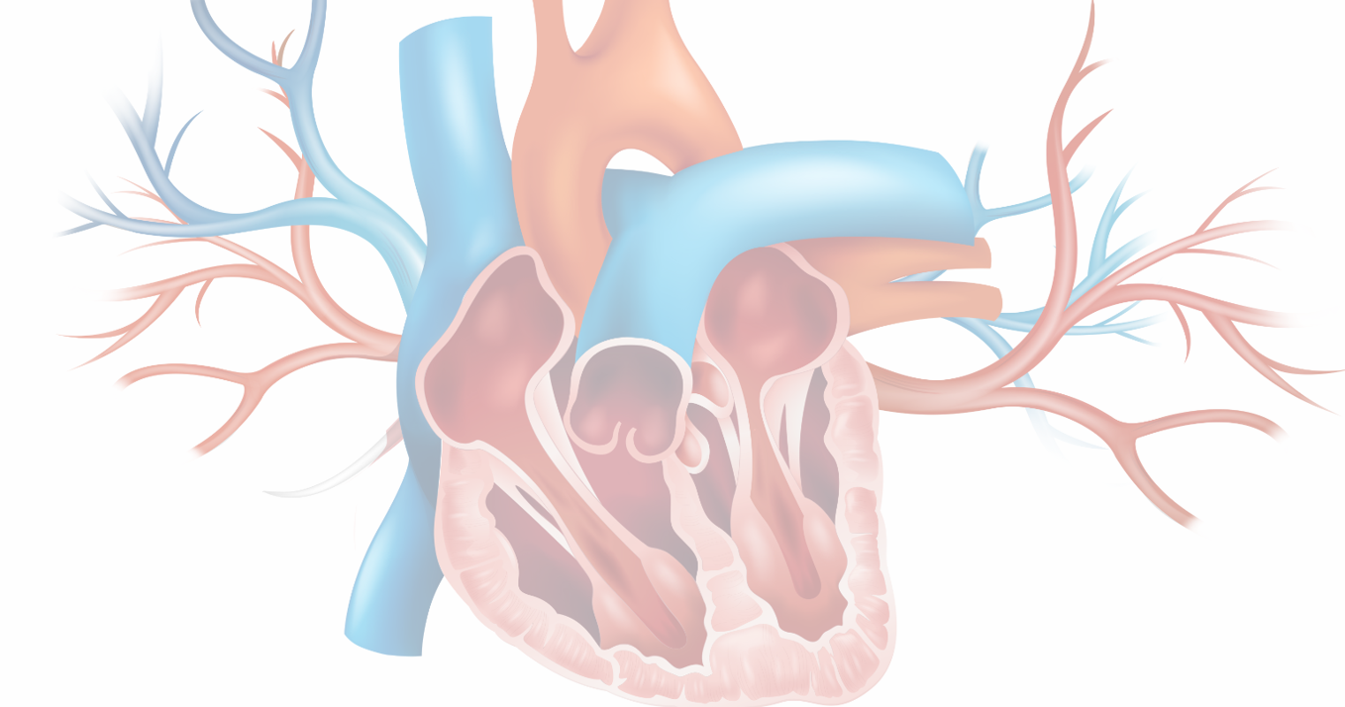
Endocarditis

Slide 2
Overview
Part 1
Pathogenesis of Subacute Bacterial Endocarditis (SBE)
Application: introduction of concepts in clinical cases
Clues for diagnosis: common signs and symptoms
Part 2
Review common microbes in bacterial endocarditis
Discuss surgical and antimicrobial treatment
Cardiac device infections

Slide 3
Bloodstream Infections
Bloodstream Infections
Intravascular Catheter
Or
Device-Related Bacteremia
Secondary Bacteremia
*Urinary tract
*Postoperative wound infections
*Skin/Skin structures
Endocarditis

Slide 4
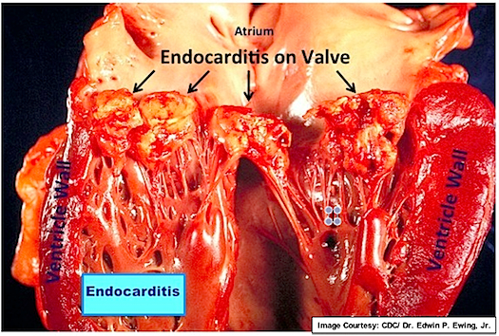
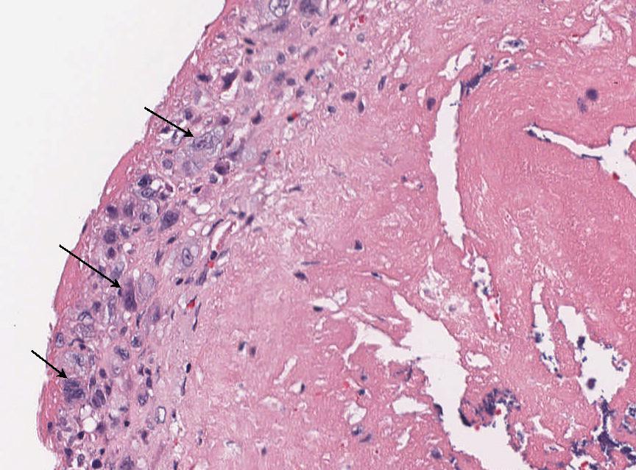
Pathogenesis of Infective Endocarditis
Valve surface is altered
  Blood turbulence, prior infection, surgery (can happen on “normal” valves but more common if damaged)
Platelets and fibrin are deposited
  Nonbacterial thrombotic endocarditis (in SLE = Libman-Sacks Endocarditis)
Bacteria in the blood adhere to the damaged valve tissue
  Colonization -> infection
Bulky, friable ‘vegetations’ are formed
Infectious endocarditis, surface of valve leaflet with fibrin and macrophages (arrows), which are seen in the acute and subacute phases of inflammation.

Slide 5
Case 1
CC: fever + malaise
67-year-old man presents to his internist with:
  Generalized malaise x 2 weeks
  Back and shoulder aching
  Night sweats x 1 week
  Fever 101°F for 3 days

Slide 6
Case 1 - continued
PMHx: HTN, HLD, seasonal allergies
  Up to date on immunizations and age-appropriate cancer screening
  Annual Medicare physical 4 months ago
  Had a cavity filled about 3 weeks ago
Medications: lisinopril, simvastatin, loratidine
ROS: otherwise unremarkable

Slide 7
Case 1 History
Social history:
  Quit smoking 25 years ago, occasionally smokes marijuana, drinks 2 glasses of wine on weekends
  Retired professor of English
  No camping, hiking, hunting, farm animal exposures
Additional history:
  1 month ago traveled to Phoenix, AZ for 1 week
  2 weeks ago watched his daughter’s new yorkie – had scratches on arms and shins he treated with neosporin

Slide 8
Physical Examination
Vitals: T= 38.7°C BP= 138/78 P=110 Resp= 22 02: 98%RA
Gen: diaphoretic and appears anxious
HEENT: PERRL, conjunctiva unremarkable, fundoscopic exam without papilledema or retinal lesions, oral mucosa without thrush or ulcers, poor dentition
Neck: supple, no lymphadenopathy
Lungs: clear bilaterally with diminished breath sounds in bases
CV: Reg, II/VI systolic murmur at the LUSB
Abdomen: soft, non-tender, normal bowel sounds, no hepatosplenomegaly
Joints: no swelling or effusions
Skin: few tiny purplish lesions on bottoms of feet

Slide 9
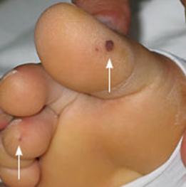
Lesion on bottom of foot
Peripheral Manifestations of Infective Endocarditis - RCEMLearning

Slide 10
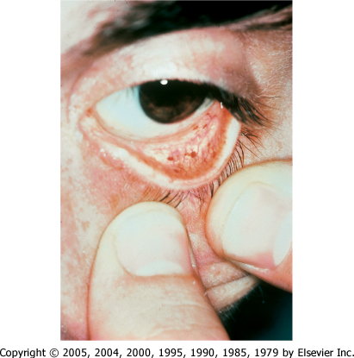

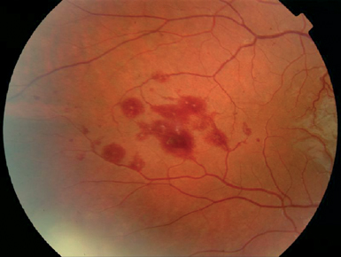
What are these lesions (below) called?
Conjunctival hemorrhages
Downloaded from: Principles and Practice of Infectious Diseases

Slide 11
Approach to Case 1
1) What is your differential diagnosis? Consider systems...
2) Create a differential diagnosis for an infection using pathogen types…
Infection
Rheumatologic
Malignancy
Cardiac
Bacteria
Virus
Fungus
Parasite

Slide 12
Laboratory
CBC
  WBC 14.3 with 95% neutrophils
  Hgb 11.6 g
  Platelets 240
CMP
  Creatinine 1.6, otherwise unremarkable
Lactate 2.0

Slide 13
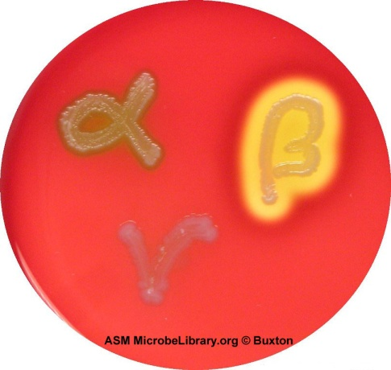
Microbiology
Multiple blood cultures – GPC, α-hemolytic streptococci, later identified: Streptococcus mitis
Species | Hemolysis
S. pyogenes | β
S. agalactiae | β, γ
S. dysgalactiae subsp. equisimilis | β
S. pneumoniae | α
S. anginosus species group | α, β, γ
S. gallolyticus species group | α, γ
S. mutans species group | α, γ, occasionally β
S. salivarius species group | α, γ
S. mitis species group | α
Viridans group streptococci

Slide 14
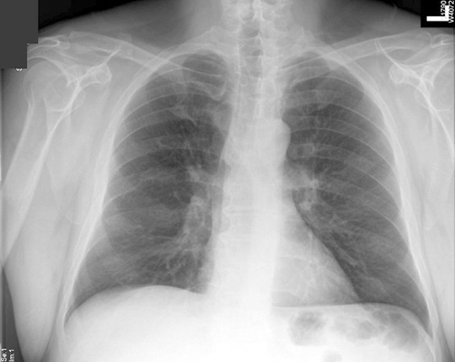
CXR
http://www.meddean.luc.edu/lumen/MedEd/radio/curriculum/Pulmonary/Structure_Thorax_f.htm

Slide 15
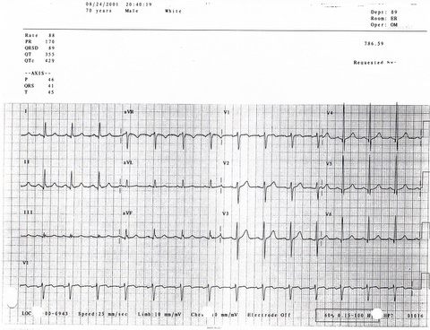
EKG

Slide 16
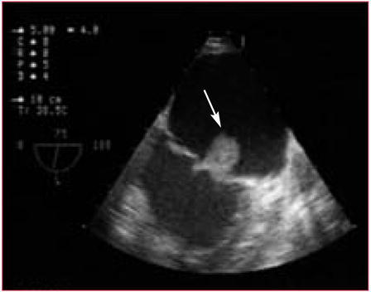
Echocardiography
2D Echocardiogram (TTE): non-diagnostic
Trans-Esophageal Echo (TEE):
    EF 60%
    Diffuse thickening of mitral valve, 0.9 cm mobile lesion on the mitral valve (arrow)

Slide 17
Symptoms of Endocarditis
Nonspecific
  Fever
  Fatigue, malaise
  Arthralgias, generalized backache
  Myalgias
System-based (if emboli involved)
  CVA
  Cough, chest pain, SOA (pulmonary emboli)
  Abdominal pain (abdominal visceral organ emboli)
  “Rash” or skin lesions (emboli to skin)

Slide 18
Signs of Endocarditis
Vascular Phenomena
Janeway lesions (skin emboli)
Small non-tender macules on palms and soles
More often found in acute bacterial endocarditis
Splinter hemorrhages
Immunologic Phenomena
Osler nodes
Late findings - seen less frequently today because of early diagnosis and treatment
Roth spots – hemorrhagic lesions of the retina
0.5 cm tender nodules (“ouch”) on the fingers, palms/soles

Slide 19
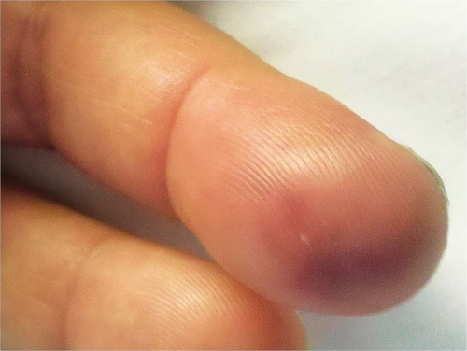
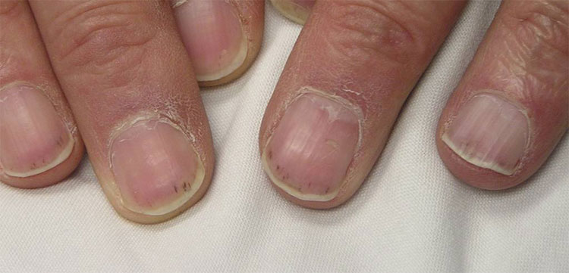
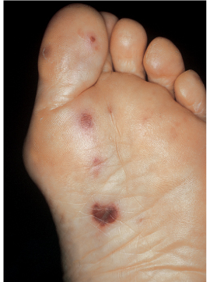
Name these lesions
Ouch!

Slide 20
Endocarditis Signs
Cardiac
  New/changing murmur
  Electrocardiographic changes - PR prolongations, heart block, ST changes
Other embolic sites
  Related to organs involved:
    Pulmonary emboli (cough, SOA)
    Spleen (pain)
    Kidney (hematuria)
    Brain (stroke)

Slide 21
Diagnostic studies
CBC (mild anemia, leukocytosis)
CMP (evaluation for end-organ dysfunction)
ESR (sensitive, not specific)
UA (microscopic hematuria?)
Blood cultures (ideally 3 sets, at least 30 min apart)
Echocardiogram and/or Cardiac CT
  [18F] FDG PET/CT
May need CNS imaging
May need CXR and/or CT scan of chest
*The 2023 Duke Criteria for diagnosing infective endocarditis
  Clinical Infectious Diseases, August 2023, 518–526, https://doi.org/10.1093/cid/ciad271

Slide 22
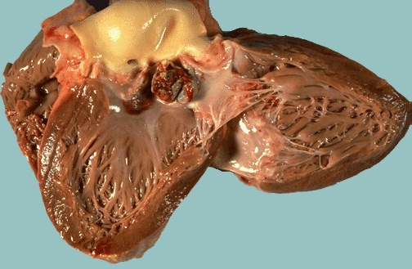
Aortic valve vegetations

Slide 23
What next?
What antibiotic would you use for our patient?
  IV Vancomycin for 8 weeks
  Levofloxacin for 8 weeks
  Oral Penicillin for 6 weeks
  IV Penicillin or Ceftriaxone for 4 weeks
  Gentamicin + Piperacillin/tazobactam for 4 weeks

Slide 24
Choosing Antibiotic Therapy
Empiric Rx
  What are the most likely pathogens?
  Is this native or prosthetic valve?
Culture-directed treatment
  What is the penicillin MIC?
    <0.12ug/mL
    0.12-0.5 ug/mL
    >0.5 ug/mL
  This will be important in guiding whether you can use PCN

Slide 25
Microbiology of SBE
Staphylococcus aureus 31%
Viridans group streptococci 17%
Enterococci 11%
Coagulase-negative staphylococci 11%
Streptococcus gallolyticus* 7%
Other streptococci 5%
Fungi 2%
“H”ACEK** 2%
  * Formerly S. bovis
  ** Fastidious gram negs: Aggregatibacter (formerly Haemophilus) aphrophilus; Aggregatibacter paraphrophilus); Actinobacillus actinomycetemcomitans (subsequently called Aggregatibacter actinomycetemcomitans); Cardiobacterium hominis; Eikenella corrodens; and Kingella kingae
The International Collaboration on Endocarditis–Prospective Cohort Study. Arch Intern Med. 2009;169(5):463–473. doi:10.1001/archinternmed.2008.603

Slide 26
“H”ACEK organisms
“H”ACEK = group of fastidious gram negs – these can now be identified more readily with improved lab techniques
  Aggregatibacter aphrophilus
    →previously Haemophilus aphrophilus/paraphrophilus
  Aggregatibacter actinomycetomcomitans
    →previously Actinobacillus actinomycetomcomitans
  Cardiobacterium hominis
  Eikenella corrodens
  Kingella kingae

Slide 27
GPC - Viridans group streptococci
Ex: S. mitis, S. sanguinis, S. mutans, S. salivarius, groups
Extracellular dextran binds to heart valves
  Catalase negative
  Alpha hemolysis
  Optochin resistant
    (normal flora of mouth & cause cavities – stay in the mouth because they are resistant to the chin)
Low virulence (tend to be slower, less destructive infections) “subacute” endocarditis compared to S. aureus “acute”

Slide 28
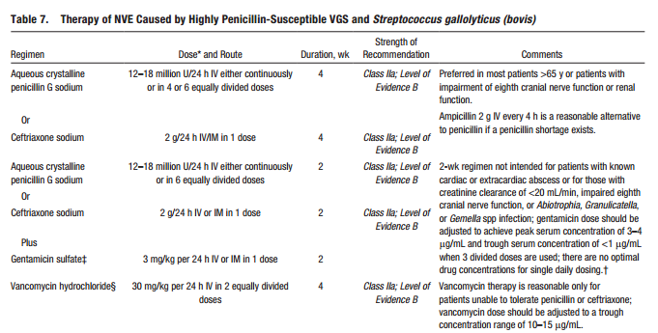
AHA/IDSA Treatment Guidelines
http://circ.ahajournals.org/content/132/15/1435 for other pathogen tables

Slide 29
General therapeutic categories to consider in the treatment of endocarditis
Native vs. prosthetic valve
Viridans group Streptococci and Streptococcus gallolyticus (formerly bovis) - Penicillin sensitivity (MIC)
Staph aureus and other staph spp.
Enterococcus spp. - Penicillin, Gentamicin, Vancomycin sensitivity
HACEK microorganisms
Culture negative (Bartonella most common in USA)
Circulation. 2015 Oct 13;132(15):1435-86. doi: 10.1161/CIR.0000000000000296. Epub 2015 Sep 15

Slide 30
Therapy for Culture Negative Endocarditis
Consider epidemiology, attempt serologic testing for Coxiella, Bartonella, etc.
Patients with acute (days) clinical presentation of native valve infection→ empiric coverage for S. aureus, β-hemolytic streptococci, and aerobic Gram-negative bacilli
Patients with a subacute (weeks) presentation of NVE → coverage of S. aureus, VGS, HACEK, and enterococci
Patients with PVE, symptoms <1 yr from valve surgery → coverage for staphylococci, enterococci, and aerobic Gram-negative bacilli
  If symptom onset is >1 year after valve placement, then IE is more likely to be caused by staphylococci, VGS, and enterococci
Circulation. 2015 Oct 13;132(15):1435-86. doi: 10.1161/CIR.0000000000000296. Epub 2015 Sep 15.

Slide 31
Surgical Therapy for Endocarditis
Surgical decisions are complex and there is limited RCT data on which to base decision-making
Early surgery (during initial hospitalization/before completion of a full course of antibiotics) is indicated in patients with IE who present with:
    New heart failure
    Heart block
    Annular/aortic abscess
    Destructive penetrating lesions
Surgery should be considered when organism is fungi, a highly drug-resistant organism, or in persistent bacteremia
If the patient has a prosthetic valve (PV), surgery should also be considered if there is PV dehiscence, intracardiac fistula, or severe PV dysfunction
Circulation. 2015 Oct 13;132(15):1435-86. doi: 10.1161/CIR.0000000000000296. Epub 2015 Sep 15.

Slide 32
Case 2
CC: fever and chest wall pain
41-year-old man presents to ER
  1 week prior to presentation developed increasing fatigue, then chills and SOA
  2 days prior Left sided chest wall pain
  Last night fever to 102ºF
Pertinent exam: ill-appearing, bibasilar crackles, no appreciable murmur, numerous scratches on both forearms
  Chest wall skin (following slide)

Slide 33
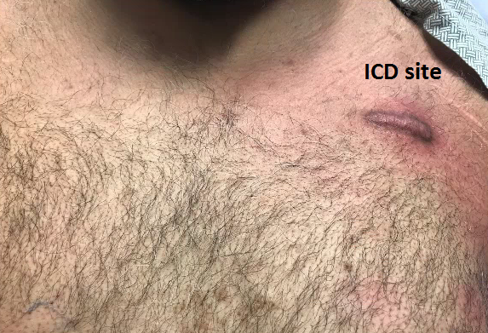
ICD Site

Slide 34
Case 2 - continued
PMHx: HTN, HLD, obesity, poorly controlled DM2 (a1c 9%), HFrEF, s/p ICD 2 years prior
Medications: lisinopril, simvastatin, carvedilol, lasix, spironolactone, lantus/aspart insulin
ROS: otherwise unremarkable

Slide 35
Other information you want to know…
Social history/exposure history?
Any history of or risk for immunocompromised status?
When was ICD placed, any complications surrounding placement?
What do you think is going on?
What diagnostics do you want?

Slide 36
Case 2 - labs
WBC= 15.1, Plt= 192K, Hgb= 12.7g
BUN= 9, Cr= 0.8
BNP 1259
Blood cultures ordered

Slide 37
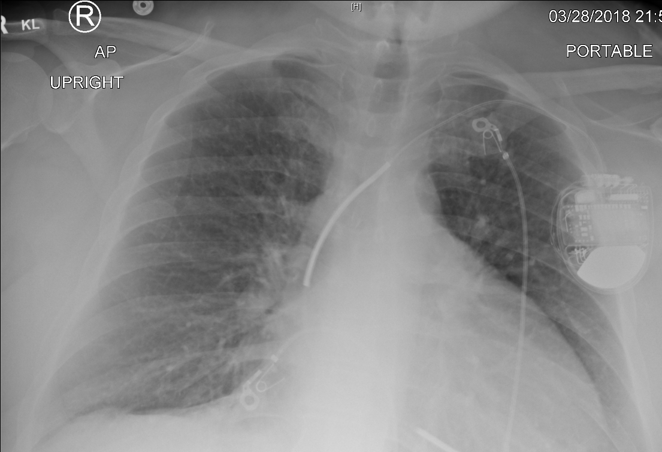
Case 2 - CXR
Pulmonary congestion

Slide 38
Cardiac Implantable Electronic Device (CIED) infection
Symptoms: pocket erythema/tenderness/incision drainage
Possibly with symptoms of SBE (fever, fatigue)
Pocket infection
  Infection involving the subcutaneous pocket containing the generator and the subcutaneous segment of the leads
    Negative blood cultures
      AND
    No lead/valve vegetation on TEE
      OR
    [¹⁸F]FDG PET/CT with abnormal activity at pocket/generator site
Systemic (Lead/Valvular) infection
  Infection involving:
    Positive blood cultures
      AND
    Lead and/or valve vegetation on TEE
      OR
    [¹⁸F]FDG PET/CT with abnormal heterogeneous activity along leads, or native or prosthetic heart valves
  Can have infection involving the subcutaneous pocket
Circulation. Volume 149, Issue 2, 9 January 2024; Pages e201-e216 https://doi.org/10.1161/CIR.0000000000001187

Slide 39
CIED infection
Device pocket infection may or may not be accompanied by bacteremia.
  In one study, intravascular lead involvement was present in 88% of patients presenting with pocket infection despite lack of symptoms of systemic infection
    J. Clin. Med. 2022, 11(19), 5898; https://doi.org/10.3390/jcm11195898
Risks
  Host: DM, ESRD, immunosuppressed, HF, older age, skin disorders
  Procedure related: Procedure duration, procedural hematoma, requirement for transvenous pacing, prior infection of device, device replacement/revision

Slide 40
Which echocardiogram technique should I use if suspicion for SBE or CIED infection?
TEE indicated
  Prosthetic valve
  Congenital heart disease
  Previous endocarditis
  Heart failure
  Stigmata of endocarditis
  Moderate to high clinical suspicion
  Difficult imaging candidate (morbid obesity, previous cardiac surgery, COPD)
  CIED (cardiac implantable electronic device w/ pocket infection)
TTE acceptable
  Low initial patient risk
  Low clinical suspicion

Slide 41
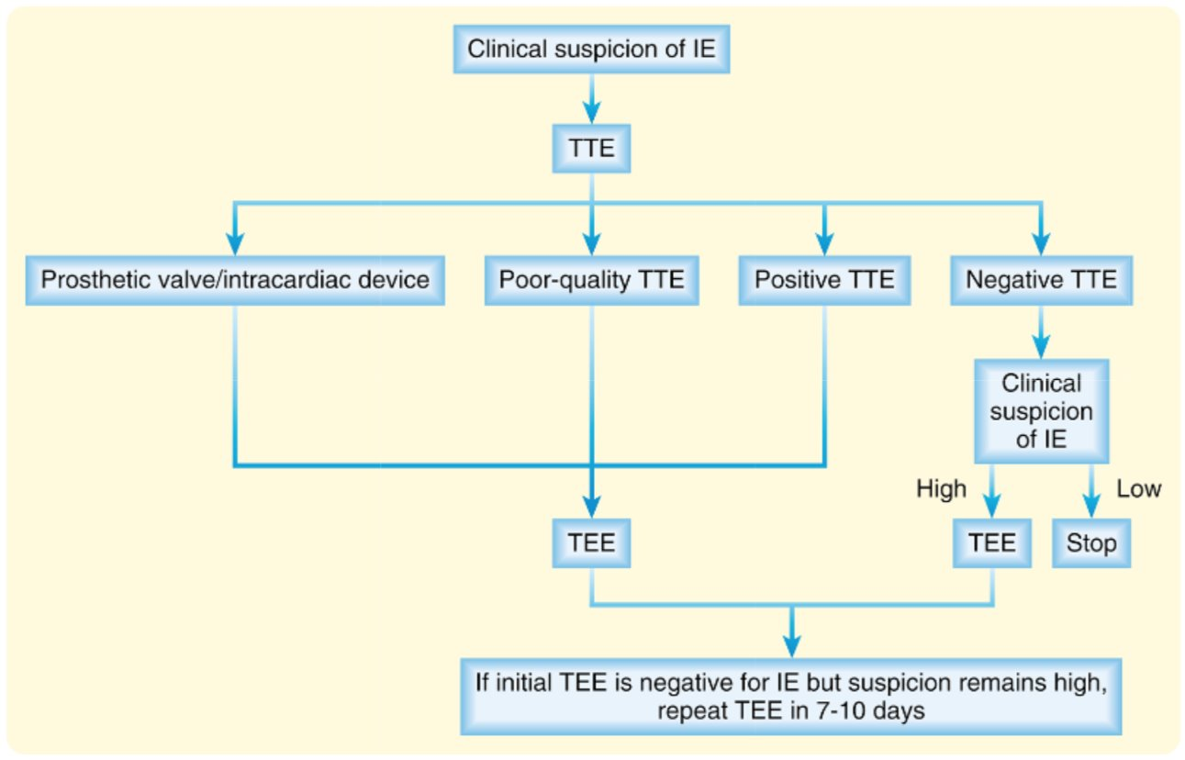
Flowchart for Clinical Suspicion of IE
Spec, Escota, Chrisler, Davies. Comprehensive review of infectious diseases. 2020.

Slide 42
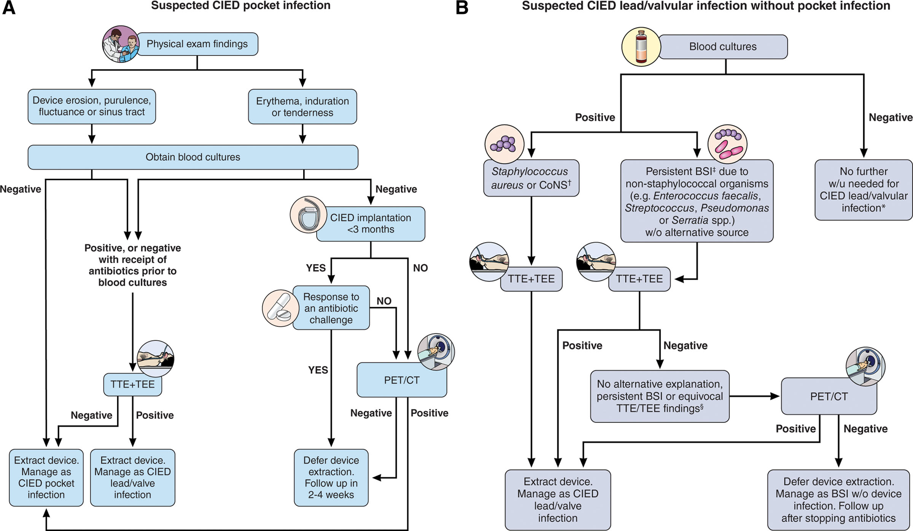
Algorithm for Suspected CIED Pocket Infevtion vs no pocket infection
Figure 3. Circulation. Volume 149, Issue 2, 9 January 2024; Pages e201-e216 https://doi.org/10.1161/CIR.0000000000001187

Slide 43
Case 2 Follow-up
Blood Cultures:
  Methicillin-susceptible Staphylococcus aureus x 2 sets
TEE
  The LV is dilated with severe global hypokinesis with an estimated EF of 15%.
  The device lead has an irregular echodensity with mobile components attached to it in the RA. It measures 2.2 x 1.2 cm. Some irregularity on the lead is also seen more distally just before insertion in the RV. These likely represent vegetations.

Slide 44
Treatment of Native Valve methicillin susceptible Staphylococcal (MSSA) IE
Treatment of Native Valve Methicillin Susceptible Staphylococcal (MSSA) IE
Drug | Duration
Nafcillin | 6 wks
Cefazolin | 6 wks
Vancomycin (if PCN allergic) | 6 wks
*vancomycin is NOT the best choice for MSSA
Circulation. 2015 Oct 13;132(15):1435-86. doi: 10.1161/CIR.0000000000000296. Epub 2015 Sep 15.

Slide 45
Treatment of CIED infection
Early (within 3 months) pocket infection can be treated with oral antibiotics if blood cultures and TEE negative
Pocket infection with bacteremia + valvular or lead vegetations:
    Remove device
    Follow treatment guidelines for SBE
    Repeat blood cultures after device removal
J Antimicrob Chemother. 2015 Feb;70(2):325-59. doi: 10.1093/jac/dku383. Epub 2014 Oct 29.

Slide 46
Summary
Blood stream infections can include:
  Catheter/line associated
  Secondary (from UTI, skin/soft tissue, etc.)
  Endocarditis +/- CIED infection
Alteration of the valve surface starts a cascade by which microorganisms can adhere to and infect the valve
Clues for diagnosis: fever, fatigue, embolic lesions
Common microbes in bacterial endocarditis include S. aureus & Viridans group streptococci
Treatment for SBE is 4-6 weeks of guideline-based antibiotic therapy in SBE or device infection with bacteremia/lead infection

Slide 47
Individual Readiness Assurance Test
What is deposited on a valve surface in SBE besides bacteria?
A patient with SBE presents with non-tender dark red spots on the distal toes, what are these called?
The lab calls you noting alpha-hemolytic gram positive cocci in chains are growing on a plated culture– list 3 options for what this may be?
What is an Osler node?
What is the most common pathogen in SBE in the US?
What is a recommended antibiotic treatment for highly penicillin-susceptible viridans strep endocarditis?
Does treatment of an ICD pocket infection (no bacteremia) require IV antibiotic therapy?
  Platelets and fibrin are first deposited on a damaged valve
  Janeway lesions
  S. pneumoniae, S. anginosus species group, S. gallolyticus species group, S. mutans species group, S. salivarius species group, S. mitis species group
  An immunologic phenomenon of SBE – skin finding of small tender nodules on the fingers, palms/soles
  S. aureus
  4 weeks of aqueous PCN G IV or ceftriaxone with 2 weeks of gentamicin
  No, typically can complete a 10-14 day course of oral antibiotics

