Slide 1
Infections in the Immunocompromised
Infectious Diseases Elective
Jayhawkid.com
Updated 3/30/26

Slide 2
Overview
Review: types of immunity
Application: clinical cases
  Type of immune deficiency, pathogen risk, differential diagnosis, treatment
Timing and type of infection in solid organ transplant
Timing and type of infection in stem-cell transplant

Slide 3
Before immunocompromised: immunity
How do we protect ourselves?
2 fundamentally different types of responses to invading pathogens
1. Innate immunity
2. Adaptive (acquired) immunity

Slide 4
Innate vs. Adaptive
Innate Immunity
“Hardwired” responses - born with this
Defense mechanisms responding immediately or within hours of an antigen’s appearance
Designed to recognize a few highly conserved structures present in many organisms (e.g. DS DNA, lipopolysaccharide, etc.)
Adaptive immunity
Immunity one develops throughout life
Slower, but able to respond to many more antigens than innate
Proliferation of B and T lymphocytes in response to antigen recognition

Slide 5
Innate vs. Adaptive Components
Innate Immunity
Phagocytic cells
  Macrophages / monocytes
Cells that release inflammatory mediators
  basophils, eosinophils, neutrophils
NK cells (innate & adaptive)
Molecular components (complement, acute phase proteins, cytokines)
Adaptive immunity
Antigen presenting cells (APCs) - macrophages / dendritic cells
B-lymphocytes
  Production of antibodies
T-lymphocytes

Slide 6
Adaptive Immunity
Adaptive Immunity
Production of antibody in response to an antigen & mediated by B-cells
Involves the production of cytotoxic T-cells, activated macrophages, activated NK cells & cytokines in response to an antigen / mediated by T-cells
Humoral
Cell-
Mediated

Slide 7
Immunodeficiency = risk for infection
T cell dysfunction (ex: HIV, Hyper IGE)
B cell dysfunction (ex: IgA def, X-linked agammaglobulinemia)
Fungal infections
  Pneumocystis
  Candida
  Cryptococcus, etc.
Viral infections
  CMV
  EBV
  HSV
Humoral immunity -> poor Ab production
Bacterial infections
  Sinopulmonary infections
  Particularly encapsulated – opsonization lacking
  S. pneumoniae, H. influenza, Neisseria, etc.
  Chronic Diarrhea
  Salmonella / Campylobacter
Certain viruses – e.g. enterovirus, rotavirus
(Fungal less likely)
CVID patients have B & T cell abnormalities with low immunoglobulins levels; treatment = IVIG

Slide 8
Generalizations Regarding Infections in the Immunocompromised Patient

Slide 9
Case 1
27-year-old man with HIV
3-4 weeks shortness of breath
  Onset initially going upstairs but more recently has been having sob with minimal activity
  1-2 weeks of non-productive cough
  Intermittent fevers to 39⁰C
  Moderate-severe headache, worsening

Slide 10
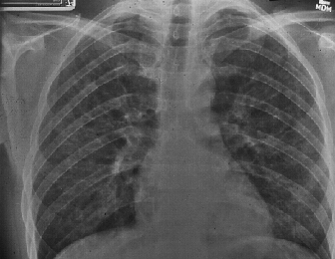
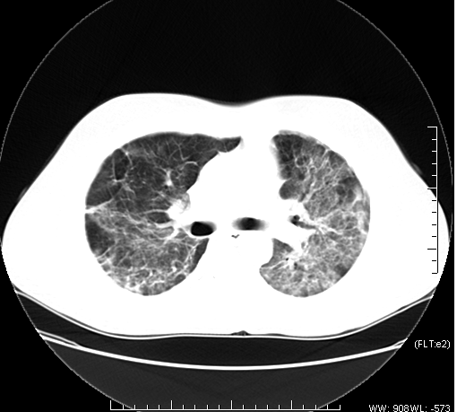
CD4 = 50 cells/ml
What is the host’s immune problem?
What pathogens are common with this immune defect?
What is the most likely diagnosis?

Slide 11
Case 1-Questions to consider
Blood & sputum culture, viruses (flu, COVID-19/influenza/RSV PCR), LDH, Fungitell, sputum silver stain, consider BAL for PJP PCR
Trimethoprim/ sulfamethoxazole + CAP abx
Not today but within 2 weeks; consider genotype first
It would lower suspicion but NOT remove PJP from differential; bactrim failure does not exclude PJP. Consider resistance mutations.
What diagnostic testing would you order?
Would you start empiric treatment? If so, what?
Should you start HIV therapy if he was not already on it?
If the patient was on bactrim prophylaxis would that influence your suspicion?

Slide 12
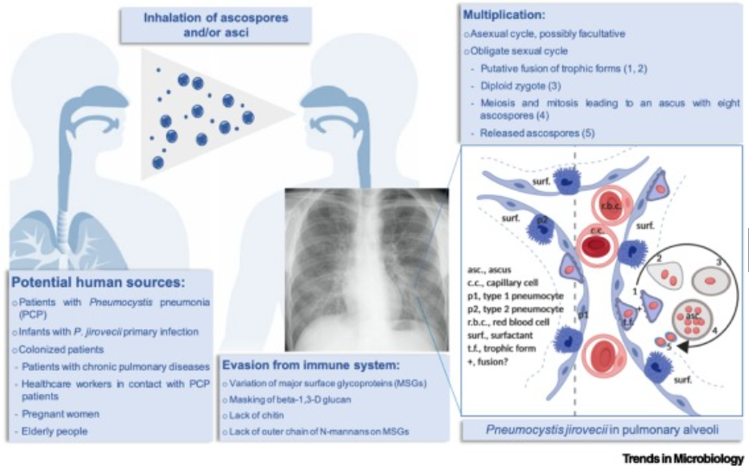
Pneumocystis jiroveci (PCP) pneumonia
The classic presenting triad:
  fever (79-100%)
  exertional dyspnea (95%) desaturation with ambulation
  nonproductive cough (95%)
Other common presenting features (nonspecific)
  fatigue
  chills
  headache
  chest pain
  weight loss
  hypoxia
Symptoms present over weeks to months

Slide 13
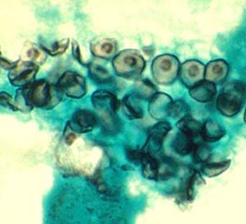
Diagnosis of PCP
Gomori Methenamine Silver Stain from induced sputum or BAL
PCR
  From induced sputum and BAL
    sensitivity 81%-100%
    specificity 86%-100%
  PCR from oropharyngeal washings and serum
    not shown to be useful
Key 2024 Guideline Update: PCR+ in respiratory samples WITHOUT symptoms/signs of respiratory disease should NOT trigger treatment (BHIVA 2024)
Notes:
Because certain processes produce similar clinical manifestations, a specific diagnosis of PCP should be sought rather than relying on a presumptive diagnosis, especially in patients with moderate-to-severe disease. Treatment can be initiated before making a definitive diagnosis because organisms persist in clinical specimens for days or weeks after effective therapy is initiated

Slide 14
Additional Diagnostic Tests for PCP
LDH
  Sensitivity 82%-100%; poor specificity
  Useful for estimating prognosis and following response
    Correlation between degree of serum elevation and survival and change in level and clinical response
Oxygenation at rest and exercise
  PJP highly unlikely if there is no drop in O2 saturation with exercise
1,3 ß-D-glucan (fungitell)
  Sensitivity 92% Specificity 65%
  PPV 85% (95% CI, 79%-90%) and NPV 80% (95% CI, 68%-89%)
Notes:
CID 2011- 408 HIV infected pt enrolled in ACTG trial a study of early versus deferred antiretroviral therapy in conjunction with initial therapy of acute OI. 65% w PCP

Slide 15
Treatment of PCP - Antibiotics
Antibiotic Table for Treatment of PCP
DRUG | Dose | Route | Comments
TMP / SMX (Bactrim) | 15-20 mg/kg/d TMP component Divided q 8hr | PO/ IV | Treatment of Choice
Primaquine + Clindamycin | 30 mg PO once daily + 600-900 IV q 8 (600mg po TID if less severe) | PO/IV | Alternate
Pentamidine | 4mg/kg or 600mg | IV | Alternate
Atovaquone | 750 mg BID | PO | Alternate (less severe)
Dapsone/TMP | 100mg + TMP 15mg/kg/day 3 divided doses | PO | Alternative (less severe)
Notes:
Mutations associated with resistance to sulfa drugs have been documented, but their effect on clinical outcome is uncertain.73-76 Patients who have PCP despite TMP-SMX prophylaxis usually can be treated effectively with standard doses of TMP-SMX

Slide 16
Treatment of PCP
Treat for 21 days
  Continue initial regimen for 4-8 days before determining treatment failure as sometimes patients will deteriorate before improving
Alternative second line agents:
  Pentamidine side effects: renal, cardiac (torsades or ventricular arrhythmias), GI (pancreatitis), hypoglycemia
  Primaquine/dapsone: methemoglobinemia and hemolysis (G6PD deficiency)
  **HIV treatment should be initiated within 2 weeks
IRIS (Immune Reconstitution Inflammatory Syndrome): Paradoxical worsening can occur after starting ART. Most cases occur within weeks of PCP episode. Continue PCP treatment; do not stop ART.
Notes:
In a randomized controlled trial of 282 patients with opportunistic infections (OIs) other than TB, 63% of whom had PCP, a significantly lower incidence of AIDS progression or death (a secondary study endpoint) was seen in subjects randomized to early (median 12 days after initiation of therapy for OI) versus deferred initiation of ART (median 45 days).99 Of note, no patients with PCP and respiratory failure requiring intubation were enrolled in the study.99 Paradoxical immune reconstitution inflammatory syndrome (IRIS) has been reported following PCP.100 Most cases have occurred within weeks of the episode of PCP;

Slide 17
Role of Steroids in PCP
Indicated for Pa 0₂ <70 or A-a grad >35 mm Hg
Also consider with progression of the disease even if they do not meet the above criteria
  Prednisone :
    40 mg PO bid x 5 days (d 1-5)
    40 mg PO QD x 5 days (d 6-10)
    20 mg PO daily x 11days (d 11-21)
Caution: Other OIs can initially respond to steroids (i.e. TB, Histo)
  As a general rule, if patients receive steroids, the diagnosis should be confirmed with induced sputum/bronchoscopy

Slide 18
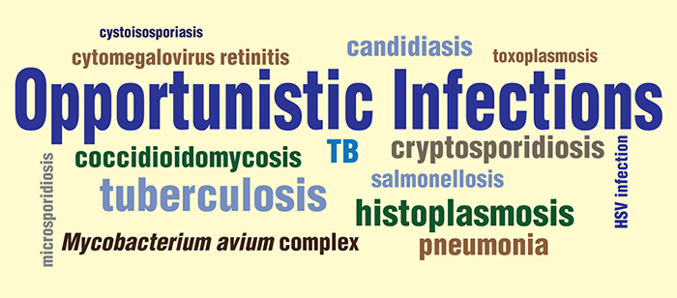
Other Opportunistic Infections in HIV
Other common OIs
  Esophageal candidiasis
  Cryptococcal meningitis
  CNS toxoplasmosis
  Disseminated Mycobacterium avium infection and TB
  CMV retinitis/esophagitis/colitis
For other OI’s:
https://hivinfo.nih.gov/understanding-hiv/fact-sheets/what-opportunistic-infection

Slide 19
Case 2
CC: skin lesion
HPI: 60-year-old male with
Nodular lesion on forearm for weeks
  New this week is ulcerating with surrounding erythema
  2 new small nodules proximal to the lesion on the forearm
Cephalexin was started by PCP
  2 days later
    Still expanding and more painful
    Swelling extended to above the elbow
Notes:
19

Slide 20
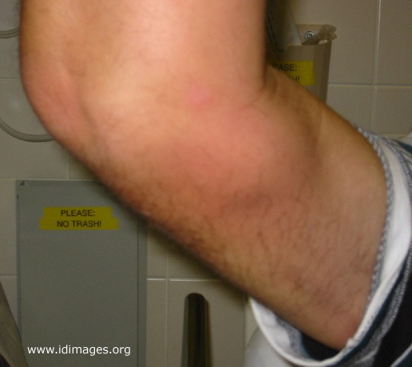
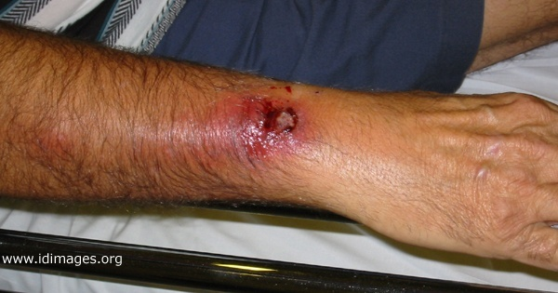
Case History
Notes:
20

Slide 21
What other history do you need?
PMHx: polymyalgia rheumatica; on prednisone 40 mg daily for 3 months; no prior history of frequent infections
Social: Married, lives w/wife – they spend winters in Florida. No other recent travel. No tob/ETOH/drug use. Retired from sales
Exposures:
  Gardens frequently; scraped arm on metal in an area of overgrown weeds 1 month ago; no rose bushes in area, occasionally sees rabbits but no direct contact. No fresh/salt water exposures, no HIV risk factors

Slide 22
Differential diagnosis
Infectious disease
  Viral:
  Fungal:
  Bacterial:
  Parasitic:
Trauma
Hematologic/onc

Slide 23
Differential diagnosis examples
Infectious disease
  Viral:
    Mpox (formerly monkeypox)
  Fungal:
    Sporothrix schenckii, Coccidiomycoses, Cryptocococcus neoformans, Histoplasmosis, Blastomycosis
  Bacterial:
    Francisella tularensis (ulceroglandular type) Nocardia brasiliensis, Bartonella henslae
    Mycobacterial: Mycobacterium marinum, Mycobacterium chelonea, Mycobacterium ulcerans
  Parasitic:
    Leishmania braziliensis
Trauma
  Tendon rupture
Heme/onc
  Thrombus, soft tissue tumor

Slide 24
Which test will be most helpful in confirming the diagnosis?
Urine antigen test
Blood culture
Stain and culture of wound
CT of arm
Serological test

Slide 25
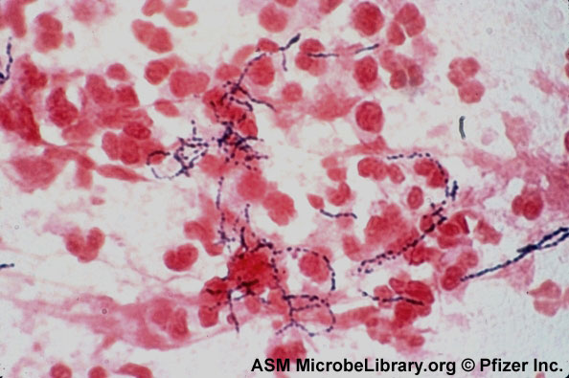
What is your diagnosis?
Notes:
25

Slide 26
Diagnosis of Nocardia
Stain
  Branching, beaded, gram-positive filaments
  Most are acid-fast in direct smears if a modified stain (Kinyoun or Ziehl-Neelsen)
  Often take up silver stains
Culture
  Grows relatively slowly (up to 2-4 weeks)
  Grows in some blood culture systems
2024 Update - Speciation: Traditional phenotypic methods now considered inadequate. Isolates should be speciated using molecular methods (e.g., 16S rRNA, secA1 gene sequencing) at qualified labs - susceptibility varies significantly by species
2024 Update - Brain Imaging: CT/MRI brain now recommended in ALL patients with pulmonary or disseminated nocardiosis to evaluate for occult CNS involvement, even without neurologic symptoms
Notes:
26

Slide 27
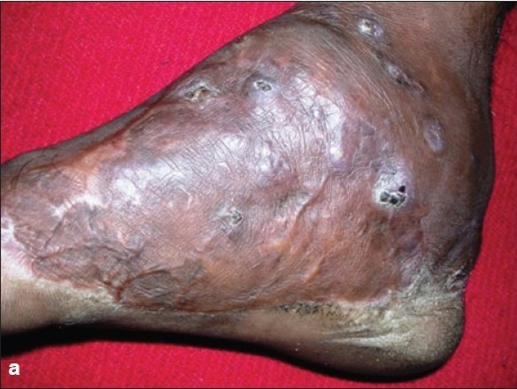
Cutaneous Manifestations of Nocardiosis
Primary cutaneous
  Results from direct inoculation
Lymphocutaneous
  Extension of untreated primary cutaneous often is initial presentation
Mycetoma
  Chronic suppurative granulomatous reaction secondary to Nocardia or other pathogens
Disseminated
  Cutaneous involvement a component of disease
http://www.ijdvl.com/viewimage.asp?img=ijdvl_2008_74_6_635_45110_u1.jpg
Notes:
27

Slide 28
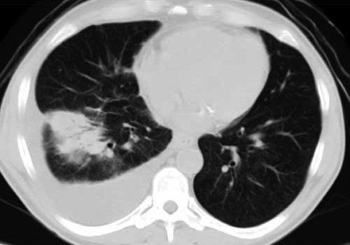
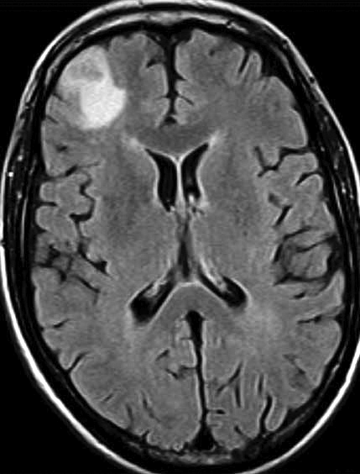
Lung and brain Nocardia lesions

Slide 29
Treatment of Nocardia
Treatment of Nocardia Based on Clinical Symptoms
Clinical Syndrome | Duration | Therapy
Cellulitis/ Lymphocutaneous syndrome | 3 mo | Oral Trimethoprim/sulfamethoxazole Minocycline Linezolid Parenteral Trimethoprim/sulfamethoxazole Amikacin Imipenem
Pulmonary or systemic
Intact host defenses | 6–12 mo
Deficient host defenses | 12 mo
CNS disease | 12 mo
Osteomyelitis, arthritis, | 4 mo
Laryngitis, sinusitis | 4 mo
2024 Update: For severe pulmonary, CNS, or disseminated disease: use 2-agent empiric therapy (TMP-SMX or linezolid + imipenem). Monotherapy adequate for localized skin/stable pneumonia. Always obtain species ID by molecular methods + susceptibility testing.
Notes:
29

Slide 30
Infections in solid organ transplant recipients

Slide 31
The Net State of Immunosuppression (Fishman, 2017)
Infection risk is dynamic, not static — it integrates multiple interacting variables:
Immunosuppressive drugs
Dose, duration, sequence — ATG and high-dose steroids carry the highest burden
Surgical complications
Fluid collections, anastomotic leaks, devitalized tissue, prolonged drains/CVCs
Neutropenia / lymphopenia
Absolute counts matter; lymphopenia drives opportunist risk
Immunomodulating viruses
CMV, EBV, HIV — active viral infection suppresses T-cell function further
Host factors
Malnutrition, uremia, diabetes, genetic polymorphisms (PTX3, IL1B, DEFB1 → mold risk)
Barrier disruption and exposure to antigens
GI surgery, mucositis, prolonged intubation, broad-spectrum antibiotics
Lung transplant exposed to more antigens than liver
Notes:
The net state of immunosuppression is a framework introduced by Jay Fishman — it's the single most important conceptual tool in transplant ID.
No single variable determines risk. A patient on low-dose tacrolimus with a bile leak, CMV viremia, and a central line is at far greater risk than a patient on ATG without any complications.
CMV deserves special mention as an immunomodulator: active CMV viremia suppresses T-cell function independently of immunosuppressive drugs, increasing risk of bacterial and fungal co-infections.

Slide 32
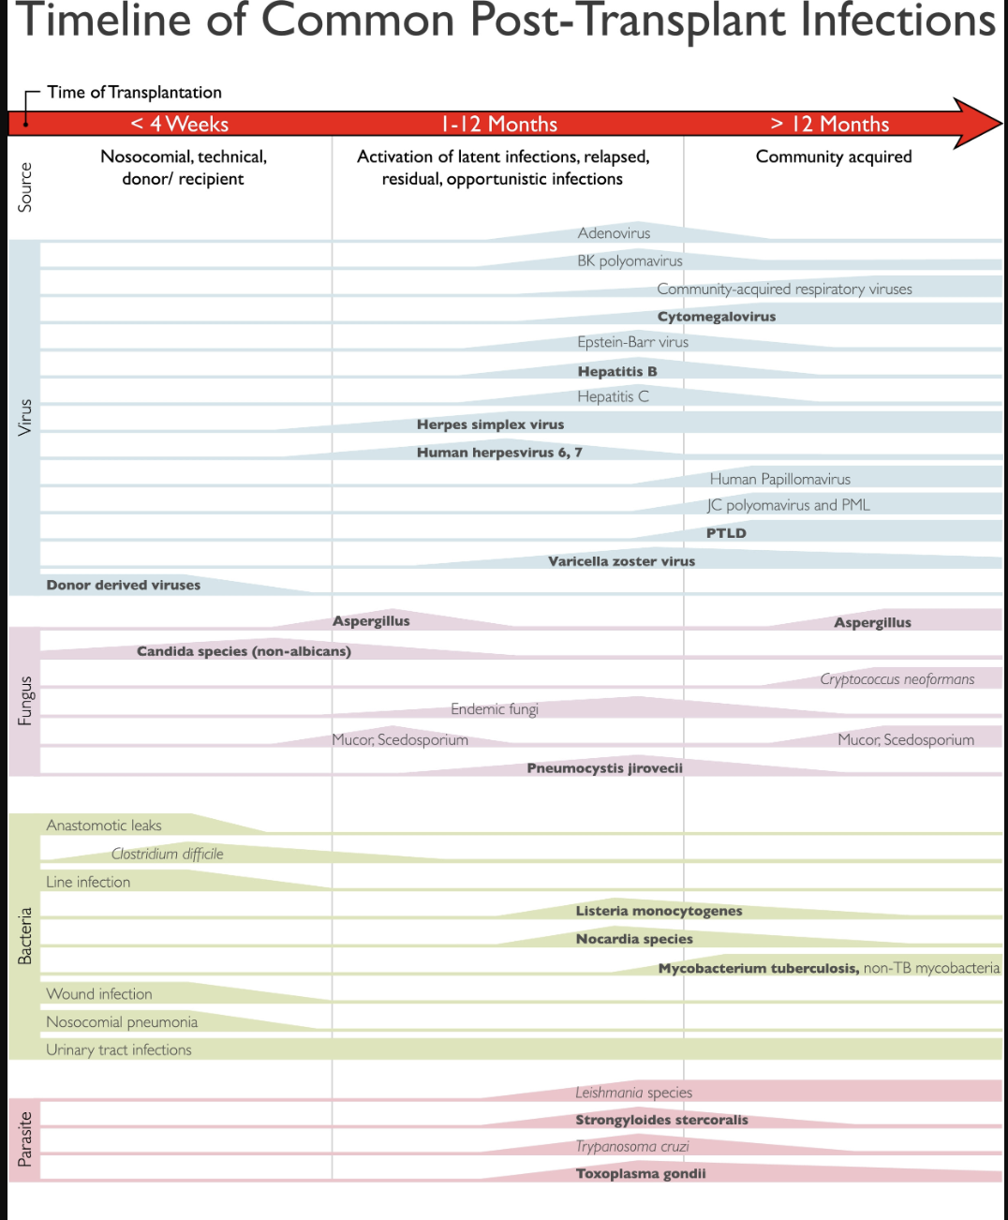
Timeline of Common Post Transplant Infections

Slide 33
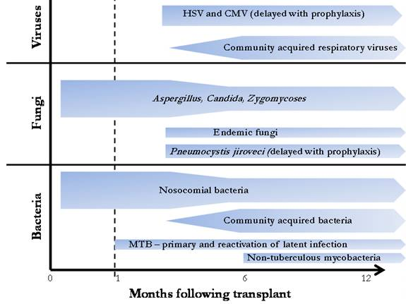
Viral infections post-transplant
CMV – lowest risk is if patient and donor are both seronegative; ranges from nonspecific febrile illness (with leukopenia/thrombocytopenia) to life-threatening organ specific infection (esophagitis, pneumonitis, colitis, hepatitis). Risk stratification: D+/R- = high risk; D+/R+ or D-/R+ = intermediate; D-/R- = low risk. Valganciclovir remains drug of choice for prophylaxis/preemptive therapy. 2025 Update: Letermovir is now an approved alternative prophylaxis option for kidney transplant recipients (avoids valganciclovir myelotoxicity). Maribavir approved for refractory/resistant CMV.
EBV – most significant complication is in post-transplant lymphoproliferative disease (fever and adenopathy)
http://www.antimicrobe.org/t35.asp

Slide 34
Case 3
35-year-old woman; history of glycogen storage disease (GSD) Type III
  S/p liver transplantation a month ago
  Immunosuppression: tacrolimus/mycophenolate mofetil/prednisone
  Routine labs: AST/ALT/T. bili - elevated
  Underwent liver biopsy = inflammation -> prednisone increased to 40 mg

Slide 35
Course
Liver enzymes improved on prednisone/tacrolimus/ MMF/sirolimus
Patient reported headache and low-grade fevers after returning home
  Readmitted for further evaluation

Slide 36
Past Medical History
Glycogen storage disorder type IIIa (glycogen debrancher deficiency) s/p OLT
Chronic hypersplenism
Pancytopenia

Slide 37
Social/exposure history
From Atchison, KS; works on farm
1 cat. No other animal exposures
No travel to desert US or abroad
No TB exposures
Vaccinations up to date
No tobacco, ETOH or recreational drug use. Does not eat undercooked meat or raw shellfish, drinks bottled water
CMV IgG+
Varicella IgG+
Rubella immune
HBV immune

Slide 38
Exam and Labs
Gen/MS: Awake, alert and oriented. Slow to answer some questions. Normal Cognition, Speech: Fluent
CN: PERRLA, EOMI, visual fields full, sensation and strength in face normal, symmetric palatal elevation, tongue is midline, Motor: Symmetric 5/5 strength. Mild RUE pronator drift
DTRs: BR 3/3, Biceps 3/3, triceps 2+/2+, patellar 3/3, ankle jerk 2+/2+, toes downgoing
Sensation: Light touch/proprioception: normal
Coordination: RUE dysmetria with “finger-to-nose”, normal “heel-to-shin”
Urinalysis: Neg
WBC: 9.3
Hgb: 12.7
Plt: 58,000
ANC: 6.5, ALC: 600
INR: 1.6
Na: 137
K: 3.5
Cl: 105
CO₂: 24
BUN: 17
Cr: .76
T. prot: 4.9
Alb: 1.9
T. bili: 37.7
Alk phos: 138
AST: 486
ALT: 529

Slide 39
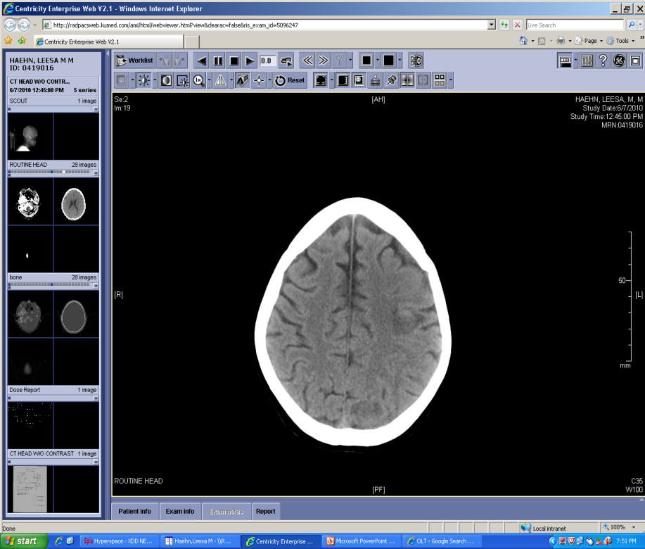
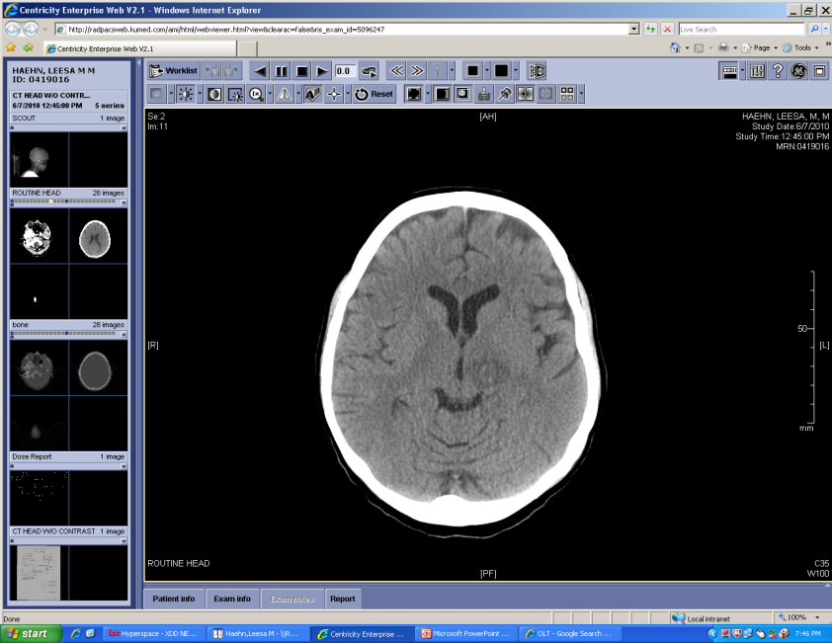
CT Head w/o contrast

Slide 40
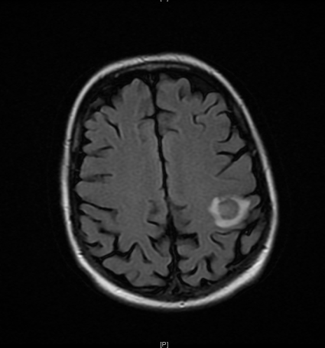
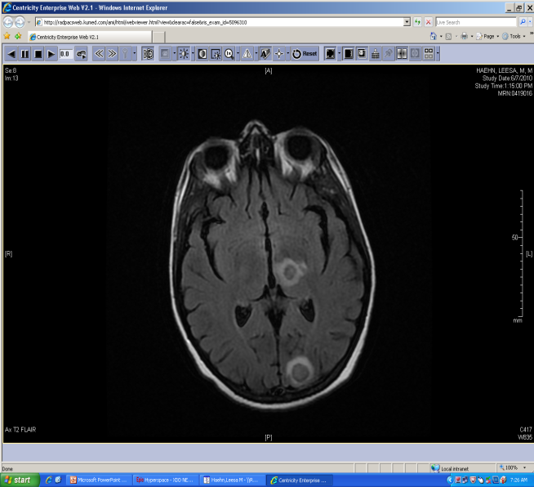
MRI T2 FLAIR images

Slide 41
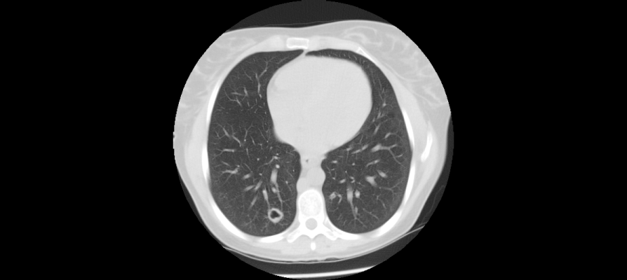
Findings prompted CT chest

Slide 42
What is the most likely pathogen?
Bacterial infection (e.g. Nocardia)
Fungal infection
Neoplasm (e.g. lymphoma)
Vascular infarct
Parasitic infection (e.g. Toxoplasma)

Slide 43
Additional studies
Laboratory:
1,3 Beta-D glucan level <31
Toxoplasmosis IgG neg
Cryptococcal ag (CSF) pos 1:64
Histo urine ag neg; CSF Histo ab neg
Serum galactomannan 0.4 (nml < 0.5)
CSF cytology negative for malignant cells
Treatment started:
Liposomal Amphotericin B 3mg/kg/day plus flucytosine started x 2 weeks
Transitioned to high dose fluconazole with plans to continue for >1 year

Slide 44
Infections in bone marrow transplant recipients

Slide 45
Infections in Bone Marrow Transplant Patients
Infections in Bone Marrow Transplant Patients
Indwelling device = CVC | Pre-engraftment < 30 days | Post-engraftment (30-100 days) | Late Phase > 100 days
Immune defect | neutropenia, mucositis, acute graft vs host disease | impaired cellular immunity; acute & chronic GVHD | impaired cellular and humoral immunity; chronic GVHD
 | Resp viruses | CMV | CMV; EBV including PTLD
 | HSV | CMV | CMV; EBV including PTLD
 | Facultative GNRs | (later) EBV PTLD | Community-acquired pneumonia
 | S. epidermidis | S. epidermidis | BK virus infection
 | Aspergillus | Aspergillus | UTI
 | Candidiasis | Candidiasis | Listeria, nocardia
 | GI streptococci | PJP
 | GI viruses | Strongyloides
 | HHV6 | Toxoplasmosis

Slide 46
Case
CC: neutropenic fever
16-year-old male was inpatient on the bone marrow transplant service. He had been diagnosed via bone-marrow biopsy of T-cell ALL with high-risk cytogenetics. He underwent induction chemotherapy, consolidation therapy then myeloablative umbilical cord transplant
On day 8 post transplant, he was neutropenic and developed fever of 39.1°C. BC were sent (negative), CT chest showed focal LLL pneumonia and he was treated with meropenem and continued on antifungal prophylaxis with micafungin and antiviral prophylaxis with acyclovir

Slide 47
Case Continued
His fever improved, then the follow week (day +15) he developed recurrent neutropenic fever with elevated LFTs, headache and diffuse maculopapular rash. He had ongoing diarrhea.
Repeat CT chest showed improved LLL infiltrate

Slide 48
Approach the case
1) Is this patient’s new condition an infection?
2) What is your differential diagnosis?
Create the differential for an infection using pathogen type…
How would the timing in respect to his transplant affect the differential…
Bacteria
Virus
Fungus
Parasite
Pre-engraftment
Post-engraftment
Late
Notes:
Risk is proportional to depth and duration of neutropenia

Slide 49
Work-up
Diagnostics:
CT head unremarkable
Repeat blood cultures negative
C. difficile PCR, rotavirus ag, cryptosporidium ag, giardia ag (neg)
1,3 Beta-D glucan level 31
Serum galactomannan 0.05
Serum CMV PCR 497,000
Serum EBV PCR neg
Skin biopsy: Purpura with sparse basal vacuolar degeneration; there are subtle signs of injury to the basal epidermis, and the differential includes early graft-vs-host disease, viral/drug exanthem, and eruption of lymphocyte recovery
Treatment started:
IV foscarnet (acyclovir prophylaxis discontinued)
Broad-spectrum antibiotics, prophylactic micafungin continued

Slide 50
Prevention of infections in transplant patients
Antimicrobials
  During neutropenia early post-bone marrow transplant: fungal agent with mold activity (i.e. posaconazole/voriconazole); trim/sulfa for PJP prophylaxis/toxo prophylaxis
  CMV prophylaxis in select patients: valganciclovir
  HSV prophylaxis if low risk for CMV: acyclovir
  PJP prophylaxis with bactrim
Immunizations
  Before transplant if feasible
  SCT patients will need revaccination after immune system reconstitution
  No live vaccinations in immunocompromised patients

Slide 51
Summary
Review: types of immunity (innate, adaptive)
Application: clinical cases
  Risk for opportunistic infections in AIDS, with glucocorticoids and other immunosuppressants such as biologics used in rheumatologic treatments
Timing and type of infection in solid organ transplant
  Consider underlying immune defects and time form transplant
Timing and type of infection in stem-cell transplant
  Depth and duration of neutropenia matters. Mold infections, respiratory and herpesviruses

Slide 52
Individual Readiness Assessment Test
  Describe innate immunity.
  Which cells proliferate in response to antigens?
  You can expect a patient with a b-cell dysfunction to have poor response to what general pathogen type?
  A patient with complement deficiency will have a poor response to what types of bacteria?
  Most patients with PCP pneumonia present with fever and what other symptoms?
  A patient with mild PCP pneumonia who is allergic to sulfa can be treated with what alternative?
  List 3 differential diagnoses for an immunocompromised patient presenting with slowly progressive nodular skin lesions.
  Late viral infections in solid organ transplant patients include:
  What are immune features of the pre-engraftment phase of stem-cell transplant patients?
Humans are born with this defense that recognizes a few conserved structures present in organisms & can respond immediately or within hours of an antigen’s appearance
B and T lymphocytes
Bacteria
Encapsulated
Exertional dyspnea (over weeks) and non-productive cough
Clindamycin + primaquine
Histoplasmosis, cryptococcosis, coccidiomycosis, sporothrichosis, atypical Mycobacterial infection, nocardiosis
VZV, CMV, EBV, BK virus
Neutropenia, mucositis & acute graft vs host disease

