Slide 1
Applying Antibiotics

Slide 2
Overview
Recognition: need for antibiotics
Application: clinical cases
  Spectrum of coverage, tissue penetration, resistance
Review of common antibiotic classes
  Penicillins, cephalosporins, aminoglycosides, quinolones
  Other commonly prescribed drugs
Back to basics (what does the susceptibility mean?)

Slide 3
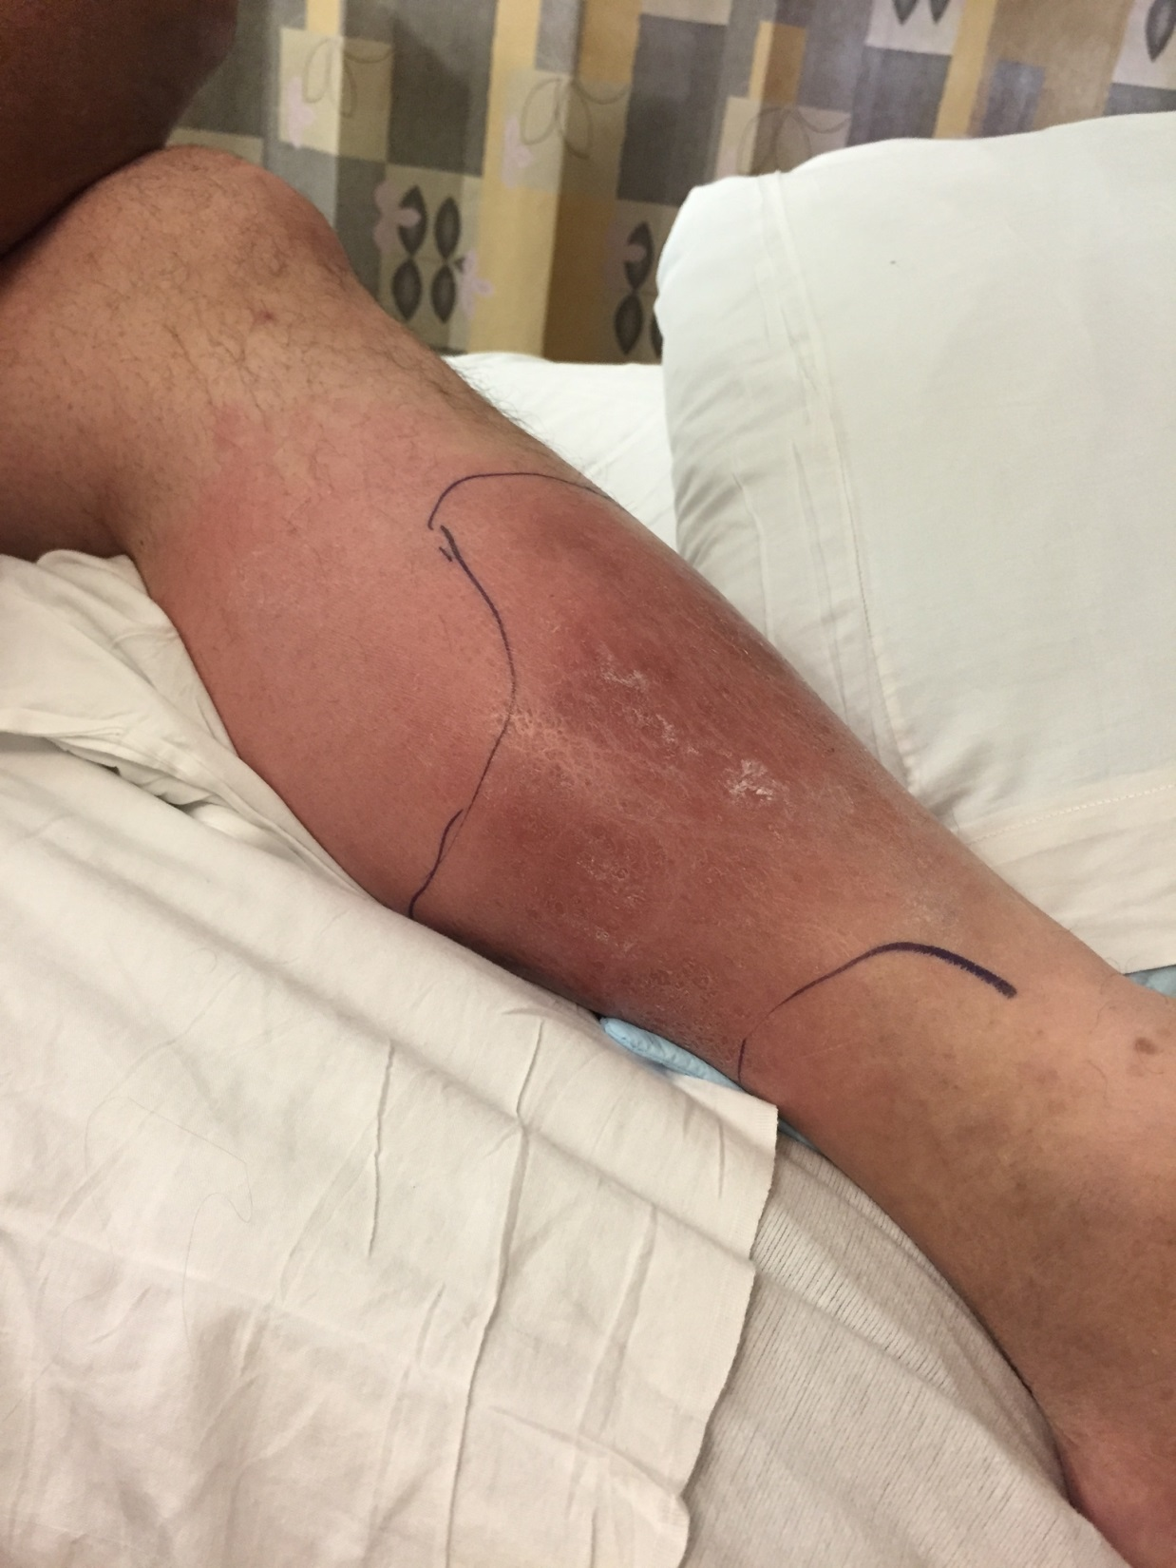
Case 1
44-year-old man presents to ED with pain, erythema L leg
WBC 12.0 with 3% bands
Doppler ultrasound of the lower extremities is negative for deep venous thrombosis

Slide 4
Approach to the case
1) Is this patient’s condition an infection?
2) What is your differential diagnosis?
3) Does this patient need antibiotics?
Create a differential diagnosis for an infection using pathogen type…
Bacteria
Virus
Fungus
Parasite

Slide 5
Classes of Antibiotics
Aminoglycosides
Beta-lactams
  Penicillins
    Aminopenicillins
    Ureidopenicillins
  Cephalosporins
    First generation
    Second generation
    Third generation
    Fourth generation
    Fifth generation
      Ceftolozane-tazobactam
      Ceftazidime-avibactam
  Carbapenems
Monobactams-Aztreonam
Folate antagonists/sulfonamides
Lincosamides-Clindamycin
Polymyxins-Colistin/polymyxin B
Macrolides
  Erythromycin
  Azalides
Tetracyclines
Chloramphenicol
Metronidazole
Fidaxomicin
Fluoroquinolones
Pleuromutilin: Lefamulin
Nitrofurantoin/Fosfomycin
Glycopepties / Lipopeptides
  Vancomycin, Telavancin, Dalbavancin, Oritavancin
Streptogramins – Quinupristin/dalfopristin
Oxazolidinone – Tedizolid, Linezolid
Cyclic lipopeptide – Daptomycin

Slide 6
Choosing an antibiotic – First step
Spectrum (What are the likely pathogens?)
  Know range of bacteria the agent is effective against
  Avoid being TOO broad if feasible
Tissue penetration (does the drug get where you want it to go?)
  Property of the antibiotic (lipid solubility, molecule size)
  Property of the tissue (blood supply, inflammation)

Slide 7
Next step(s)
Antibiotic resistance (is there resistance amongst pathogens you are considering?)
  Inherent or acquired
Safety Profile (what are side effects, is benefit > risk?)
Cost (is there a more cost-conscious alternative?)
Is there a guideline to help you choose?

Slide 8
Our patient: Cellulitis
Spectrum
  What are normal flora of the human skin??
  Avoid being TOO broad
    Probably don’t need gram-negative, Pseudomonas, or anaerobe coverage in our patient
Tissue Penetration
  Skin and soft tissue
Is there a guideline-based choice?

Slide 9
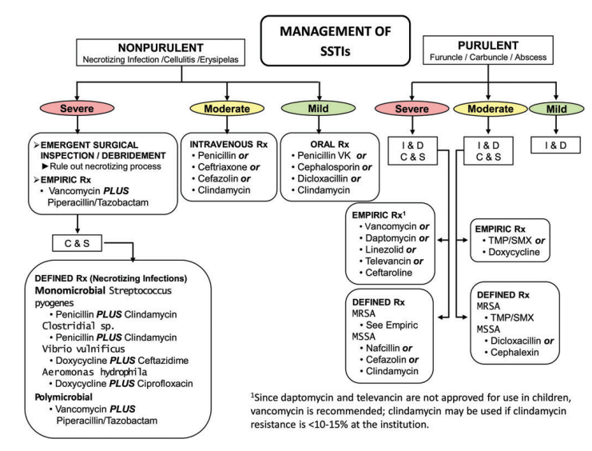
Management of SSTIs
He has non-purulent cellulitis
He has a moderate infection (admitted)
Figure 1. IDSA 2014 Guidelines for the Diagnosis and Management of Skin and Soft Tissue Infections
Practice Guidelines for the Diagnosis and Management of Skin and Soft Tissue Infections: 2014 Update by the Infectious Diseases Society of America

Slide 10
Case 1 follow-up
Left leg cellulitis
  Non-purulent (differential: Streptococci >> MSSA, MRSA > S. epidermidis)
  Severity: moderate, want to penetrate skin/soft tissue
  Treatment options: cefazolin, ceftriaxone, clindamycin, penicillin
    Choice for this patient if hospitalized: cefazolin
Continued clinical improvement and transitioned to oral therapy after 48 hours
  Several options; consider oral 1st generation cephalosporin

Slide 11
β-lactams - Penicillins
Penicillins
  Aminopenicillins (ampicillin/amoxicillin)
    Good for: strep, susceptible enterococci
      Common uses: GAS pharyngitis, acute otitis media
    Can combine w/b-lactamase: Ampicillin/sulbactam, Amoxicillin/clavulanate
      Adds anaerobe coverage; now good for dental infection, bacterial sinusitis
  Anti-staphylococcal penicillins (oxacillin/nafcillin/dicloxacillin)
    Good for: MSSA, strep, NOT enterococci
      Common uses: MSSA infections; watch for interstitial nephritis
  Extended spectrum (anti-pseudomonal): piperacillin/tazobactam
    Good if you need strep + enterococcus, gram negative including PSAE and anaerobe coverage
  Consider: allergy (10% report allergy, 90% of those do not have PCN IgE)

Slide 12
Cephalosporins
Generation | 1st | 2nd | 3rd | 4th | 5th
S. aureus | +++ | ++ | + | + | +
MRSA | - | - | - | - | +
Enterococcus | - | - | - | - | -
Enteric GNB | + | ++ | +++ | +++ | +++
Pseudomonas | - | - | ++/* | +++ | +++**
Anaerobes | - | ++/-*** | - | - | -
*Antipseudomonal – Ceftazidime (3rd)
**Ceftolozane-tazobactam, Ceftazidime-avibactam
***Anaerobic - Cefoxitin, Cefotetan (2nd)
♘ Cefiderocol – 4th generation siderophore cephalosporin – MDR infections including Pseudomonas, Enterobacteriaciae, Acinetobacter baumanii

Slide 13
Carbapenems
Bacterial Group | Ertapenem | Imipenem | Meropenem/Doripenem
Gram +s | ++ | ++ | ++
MRSA | - | - | -
Enterococcus | - | - | -
Enteroic GNB | ++ | ++ | ++
Pseudomonas | - | ++ | ++
Anaerobes | ++ | ++ | ++
Stenotrophomonas | - | - | -
MDR-Acinetobacter | - | - | -
Imipenem/cilastatin-relebactam
Meropenem-vaborbactam

Slide 14
Monobactam (Aztreonam)
4-member β-lactam ring only
  Can use in penicillin-allergic patients
NO activity against gram-positives or anaerobes
Binds preferentially to PBP 3 of gram-negative aerobes
  E. coli, K. pneumoniae, P. mirabilis, S. marcescens
  H. influenzae, M. catarrhalis
  Enterobacter, Citrobacter, Providencia, Morganella
  Salmonella, Shigella
  Pseudomonas aeruginosa (check antibiogram for susceptibility)

Slide 15
Clindamycin
Activity for:
  Gram-positive cocci
    S. aureus (some MSSA, some MRSA), Streptococcus A, B, C, G including S. pneumoniae
  Anaerobes
    Good for dental/oral infections and toxin-binding (clostridial infections and in GAS Toxic Shock Syndrome)
  Other
    Pneumocystis, Toxoplasma gondii, malaria

Slide 16
What if it was purulent cellulitis?
Purulent cellulitis: more likely staphylococcus
For moderately severe infection:
  Vancomycin (glycopeptide)
    Can cause acute kidney injury, infusion reaction = red man syndrome (from histamine release – not true allergy); if occurs can slow infusion and pre-medication with tylenol/Benadryl
    Other options in class: telavancin, dalbavancin, oritavancin
  Linezolid/tedizolid (oxazolidinone) – resistant gram + infections
    Can suppress bone marrow, cause neuropathy, serotonin syndrome
  Daptomycin (lipopeptide) – resistant gram + infections (not PNA)
    Monitor for increased CPK

Slide 17
Case 2
CC: fever/chills
76-year-old male with DM (A1c 6.8), s/p left BKA (due to complicated PVD), CAD s/p CABG in 1994, PPM
  Started having chills, fever to 102°F; symptoms progressed over 3 days and he was admitted to a community hospital for assessment
ROS:
  Pertinent positives: anorexia, fatigue
  Negative: HA, sinus congestion, rhinorrhea, sore throat, cough, chest pain, n/v/abdominal pain, diarrhea, muscle or joint pains, rash

Slide 18
History
Social/exposure history:
  Marital status/residence: married, lives w/wife
  Job/occupation: retired; works in woodworking in free time
  Travel history: none recent, no travel to desert SW or abroad
  Animal, bird exposures: outdoor cats on property
  Environmental/outdoor/food exposures: water leaking in his workroom, sawdust, moldy wood
  Recent ill contacts: no
  TB exposure: none
  Drugs of abuse: no
  Tobacco: former smoker
  ETOH: denies

Slide 19
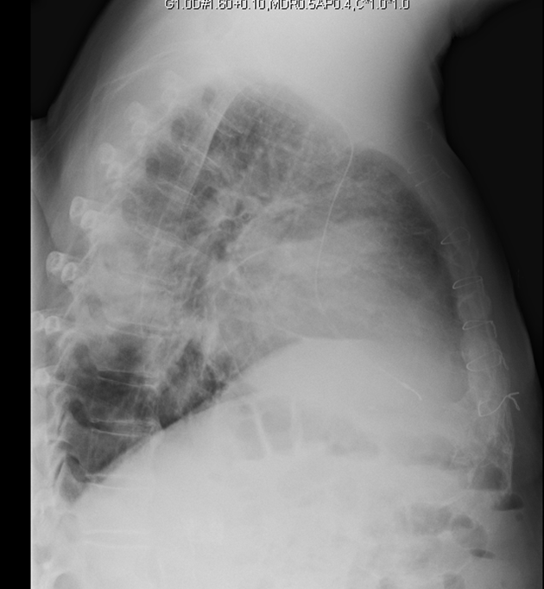
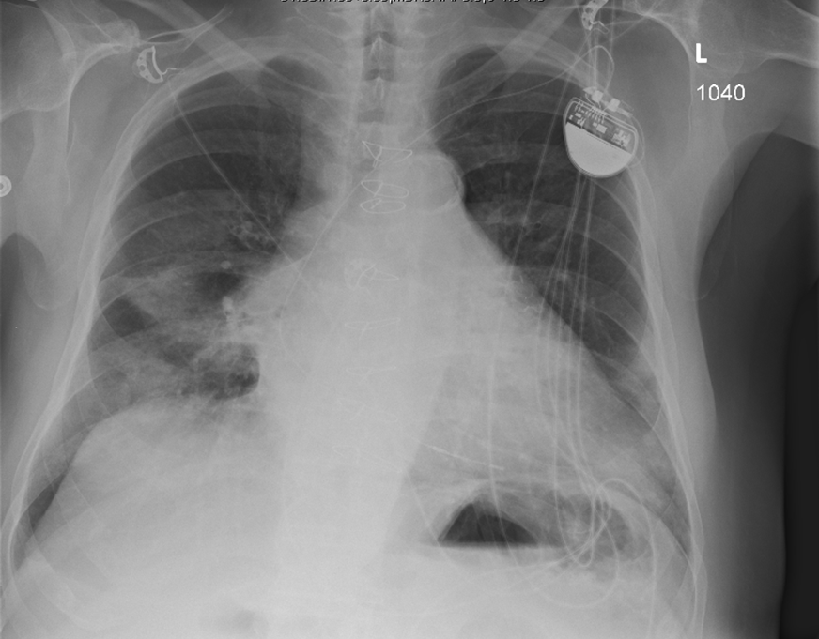
Chest XR Imaging – Anterior & Lateral

Slide 20
Initial impression
What is your initial assessment?
What is on your differential for pathogens involved?
What antimicrobial therapy would you start?
What other diagnostics would you consider?

Slide 21
Course
Started on empiric antibiotic therapy with ceftriaxone and azithromycin
  Still febrile at 48 hours on antibiotics
  No improvement in symptoms; antibiotic changed to pip/tazo
  CT with bilateral pleural effusions – concern for empyema so transferred to tertiary care center on pip/tazo monotherapy
On arrival he was afebrile, VS within normal range
  WBC 8.2 w/84% neut, Hgb normal. Na 136, K 4.6, Creat 1.2,
  Transaminases were normal though bilirubin 2.3.
  UA was unremarkable.

Slide 22
Further workup?
From community hospital
  – blood cultures were negative from admit
  – sputum culture was unable to be obtained
What other diagnostics would you consider?
What if anything would you change for antimicrobial coverage?
Legionella urine ag returned positive

Slide 23
Community-acquired pneumonia
Spectrum (What is your likely pathogen?)
  Streptococcus pneumoniae, Haemophilus influenzae, Mycoplasma pneumoniae, Chlamydophila pneumoniae, Legionella
  Want to avoid being TOO broad
    Probably don’t need ESBL, Pseudomonas, anaerobe coverage
Appropriate site of action (does the drug get where you want it to?)
  Lung → no daptomycin (inactivated by surfactant)

Slide 24
Next Steps in Choosing an Antibiotic
Antibiotic resistance
  Inherent or acquired
  Genetic variability:
    Microevolutionary: point mutations
    Macroevolutionary: inversions, duplications, insertions, deletions, or transposition of large sequences of DNA from one location of a bacterial chromosome or plasmid to another (transposons or insertion sequences)
    Acquisition of foreign DNA carried by plasmids, bacteriophages, or transposable genetic elements
Pharmacodynamics/pharmacokinetics
Safety profile & cost
Is there a guideline-based choice?

Slide 25
Our armamentarium (CAP)
Tetracyclines
  Doxycycline
  Minocycline
Fluoroquinolones
  Levofloxacin
  Moxifloxacin
  Ciprofloxacin
  Delafloxacin
β-lactams
  Penicillins
    Aminopenicillins
  Cephalosporins
    3rd generation
    4th generation
    5th generation
Macrolides
  Azithromycin
  Clarithromycin
  Erythromycin

Slide 26
IDSA guidelines for CAP treatment
https://www.idsociety.org/practice-guideline/community-acquired-pneumonia-cap-in-adults/
Admitted to the Floor:
Anti-pneumococcal β-lactam (Cefotaxime, Cetriaxone, Amp-sulbactam, Ertapenem) + macrolide (or doxycycline)
OR: Respiratory fluoroquinolone (Levaquin or moxifloxacin)
Admitted to the ICU (severe CAP):
Anti-pneumococcal β-lactam (Cefotaxime, Cetriaxone, Amp-sulbactam, Ertapenem) + macrolide (or doxycycline)
OR: Anti-pneumococcal β-lactam (Cefotaxime, Cetriaxone, Amp-sulbactam, Ertapenem) + resp fluoroquinolone (moxifloxacin or levaquin)
OR: For Penicillin allergic patients – respiratory fluoroquinolone (moxifloxacin or Levaquin) + aztreonam
Prior PSAE colonization or chronic lung disease:
Anti-pneumococcal and anti-pseudomonal β-lactam (pip/tazo, cefepime, meropenem, imipenem) + ciprofloxacin or Levaquin; *n some cases, an aminoglycoside may need to be added
For PCN-allergic patients, substitute aztreonam for the β-lactam
If CA-MRSA is a concern:
Add IV vancomycin or linezolid , or use Ceftaroline + atypical coverage

Slide 27
Macrolides
Azithromycin, Clarithromycin, Erythromycin
Good activity against CAP pathogens
  Atypical: Chlamydia spp., Mycoplasma spp., Legionella
  Typical: S. pneumo, MSSA, upper airway anaerobes
Azithro/clarithro: MAI (Mycobacterium avium intracellulare) and other non-tuberculous mycobacteria
Other uses
  Treponema pallidum (but high resistance known), Campylobacter, Borrelia, Bordetella, Brucella, Pasteurella

Slide 28
Tetracyclines
Doxycycline
  Potential uses
    Community-acquired respiratory tract infections (atypicals, S. pneumo)
    Skin/soft tissue infections (staph)
    Chlamydia
    Tick-borne infections
      (Lyme, RMSF, Ehrlichia, Tularemia)
    Helicobacter pylori
Minocycline
  Oral therapy for MRSA, activity for some Stenotrophomonas, used to treat acne
Watch for: photosensitivity, discoloration of teeth and skin

Slide 29
Fluoroquinolones
Only oral therapy option for some Pseudomonas infections
Anaerobic potential (moxifloxacin)
Atypical Bacteria –
  Legionella, Chlamydia spp.
  Mycoplasma spp., Ureaplasma urealyticum – concern for macrolide resistance
Delafloxacin – approved for skin/soft tissue (active for MRSA)
Potential adverse reactions/toxicities
  QTc prolongation - Torsades de Pointes (not reported for delaflox)
  Arthropathy – more in older adults
  Tendon rupture- any quinolone, less for delaflox

Slide 30
Case 3
CC: neutropenic fever
18-year-old male was inpatient on the bone marrow transplant service. Diagnosed via bone-marrow biopsy with T-cell ALL with high-risk cytogenetics.
Underwent induction chemotherapy, consolidation therapy, then myeloablative umbilical cord transplant 8 days ago.
On day 8 post transplant, he was neutropenic and developed fever of 39.1°C

Slide 31
Case 3 (continued)
Day +8:
T: 39.1°C, RR: 22, BP: 110/65, O2 sat: 96% RA
Exam: petechiae on lower legs, trifusion catheter R chest wall non-tender with no erythema. He had L>R bibasilar crackles.
Lab: WBC 0.1, hgb 8.5g, plt 22,000
A CT chest is ordered to evaluate the lower lobe crackles.
Patient needs empiric antibiotic therapy for neutropenic fever.

Slide 32
Choosing your Drug
Spectrum
Appropriate site of action
Antibiotic Resistance
Pharmacodynamics/pharmacokinetics (this patient has no host immune defense– needs bacteriocidal drug that will kill pathogens independently)
Safety profile & cost
*What would you choose and why?

Slide 33
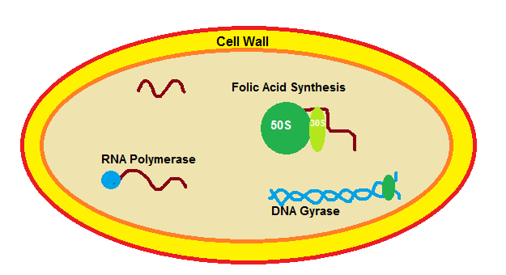
Antibiotic Mechanisms of Action
Cell Wall Synthesis
Peptidoglycan-synthesis: Vanco
Peptidoglycan-cross-link: b-lactams
Penicillins
  Aminopenicillins
  Anti-staph PCNs
  Ext-spectrum
Cephalosporins
  First generation
  Second generation
  Third generation
  Fourth generation
  Fifth generation
  Ceph+β-lactamase inhibitors
Carbapenems
    Carba+β-lactamase inhibitors
Monobactam-Aztreonam
Folic Acid Synthesis
Sulfonamides
50S ribosomal subunit
Macrolides
  Erythromycin
  Azalides
  Ketolides
Clindamycin
30S ribosomal subunit
Tetracyclines
  Minocycline
  Doxycycline
Aminoglycosides
  Tobramycin
  Gentamicin
  Amikacin
Cell Membrane Function
Daptomycin
Colistin
RNA Polymerase
Rifampin
DNA integrity (free radicals)
Metronidazole
DNA Synthesis
Fluoroquinolones

Slide 34
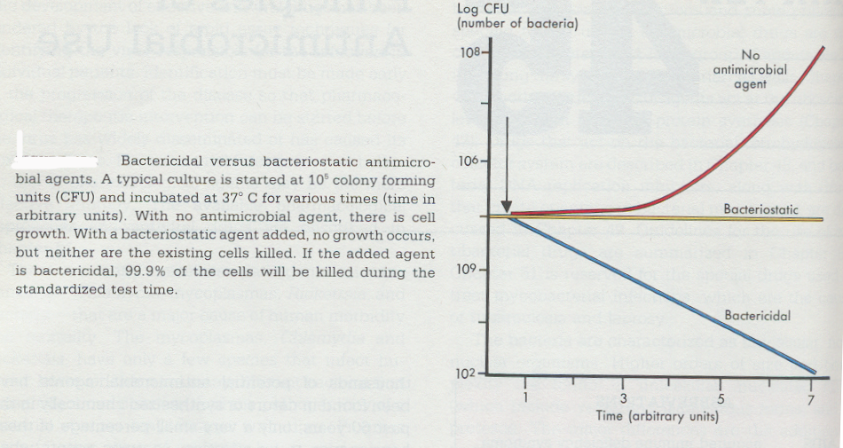
Bactericidal versus Bacteriostatic
Bactericidal: kills bacteria –
Can eradicate pathogen in the absence of host immune defense mechanisms
Bacteriostatic: inhibits bacteria-
Requires host immune defense mechanisms to eradicate the infection
Cefepime
In general, cell wall - active agents are bactericidal and drugs inhibiting protein synthesis are bacteriostatic
*Some bactericidal drugs may be bacteriostatic to certain organisms

Slide 35
Bacteriocidal vs. static
Cell Wall Synthesis
Peptidoglycan-synthesis: Vanco
Peptidoglycan-cross-link: b-lactams
Penicillins
  Aminopenicillins
  Anti-staph PCNs
  Ext-spectrum
Cephalosporins
  First generation
  Second generation
  Third generation
  Fourth generation
  Fifth generation
  Ceph+β-lactamase inhibitors
Carbapenems
    Carba+β-lactamase inhibitors
Monobactam-Aztreonam
Folic Acid Synthesis
Sulfonamides
Folid Acid Synthesis
Trimethoprim/sulfamethoxazole
50S ribosomal subunit
Macrolides
  Erythromycin
  Azalides
  Ketolides
Clindamycin
30S ribosomal subunit
Tetracyclines
  Minocycline
  Doxycycline
Aminoglycosides
  Tobramycin
  Gentamicin
  Amikacin
Cell Membrane Function
Daptomycin
Colistin
RNA Polymerase
Rifampin
DNA integrity (free radicals)
Metronidazole
DNA Synthesis
Fluoroquinolones

Slide 36
Bacteriocidal Uses
Bacteriocidal drugs – use in:
  Neutropenia, severely compromised immune system
  Life-threatening infections (bacteremia, endocarditis, meningitis, brain abscess)

Slide 37
Case 4
CC: fever
A 22-year-old male sustained polytrauma from MVA including multiple broken bones, closed head injury and chest contusions. He has been in ICU for 25 days with fever of 38-39°C x 6 days
  4 days ago he was started on daptomycin for suspected central line infection
  2 days ago Cefepime & levofloxacin were added for possible hospital acquired pneumonia

Slide 38
Case 4 - continued
Despite this addition, over the past 24 hours he has developed increased WBC from 13→17K, hypotension requiring Norepinephrine, increased sputum production and diffuse muscle aches.
    Why might he now be developing septic shock?
    What organisms are not covered by his current regimen?
    What would you consider changing?
    Could he be having an adverse antibiotic reaction?

Slide 39
Daptomycin
Lipopeptide; active only for gram positive bacteria
  Staph (including MRSA), Strep (also including VRE – E. faecalis, E. faecium)
  Gram positive anaerobes – Peptostreptococcus
Bactericidal
Indicated for bacteremia and right sided endocarditis
Not indicated for pneumonia…why?
Increase in serum creatinine phosphokinase (CPK) and may cause myalgias, myopathy
  Given once daily to reduce muscle toxicity
  Need close monitoring of CPK

Slide 40
Vancomycin
Glycopeptide; no gram-negative coverage
Gram-positives
  MSSA, MRSA, CoNS
  S. pneumoniae, groups A, B, C, D strep, Enterococcus
  Corynebacterium, Bacillus, Listeria, Actinomyces
  C. difficile (if given orally)
Side effects:
  Red man syndrome (not an allergy – is due to histamine release), phlebitis
  Nephrotoxicity – monitor drug levels to adjust dosing

Slide 41
Case 4, cont.
His sputum gram stain shows gram positive cocci in clusters
You stop Daptomycin and switch to Vancomycin while awaiting cultures
Sputum grows MRSA and you discontinue the Cefepime and levofloxacin
Over the next 48 hours he develops acute kidney injury
What other agent may be useful in this case?

Slide 42
Linezolid
Oxazolidinone; no gram negative coverage
Gram positive
  MRSA, CoNS, drug resistant Streptococcus pneumoniae (DRSP), VRE (E. faecalis and E. faecium)
Bacteriostatic
Reactions:
  Cytopenias
  Optic neuropathy (particularly if used > 2 wks)
  Price tag shock

Slide 43
Clinical Case 4
What if instead, the sputum was growing Pseudomonas aeruginosa?
What treatment options do you have?

Slide 44
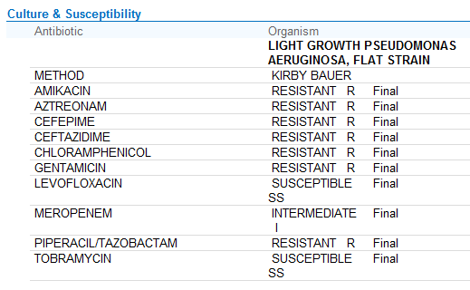
Antibiotic susceptibility ex. PSAE

Slide 45
Tailoring your therapy
Adjust any coverage based on susceptibilities
  Did you identify a resistant pathogen?
Safety profile & cost
  Would you choose levofloxacin or tobramycin?
Narrow your coverage
  If he would have been started on Vancomycin, cefepime and tobramycin for HAP, could we stop any of the agents OR change a broad-spectrum agent to a narrower spectrum agent?

Slide 46
Aminoglycosides
Tobramycin
  Most potent for Pseudomonas aeruginosa
Gentamicin
  Most commonly used of this class for GNR
  Used for synergy in Enterococcus bacterial endocarditis
Amikacin
  Least likely for resistance to occur from inactivating enzymes
  Useful also for mycobacterial infection
Dosing:
  Hartford nomogram (use a reference)
  Extended interval (Zaske kinetics – use a reference)

Slide 47
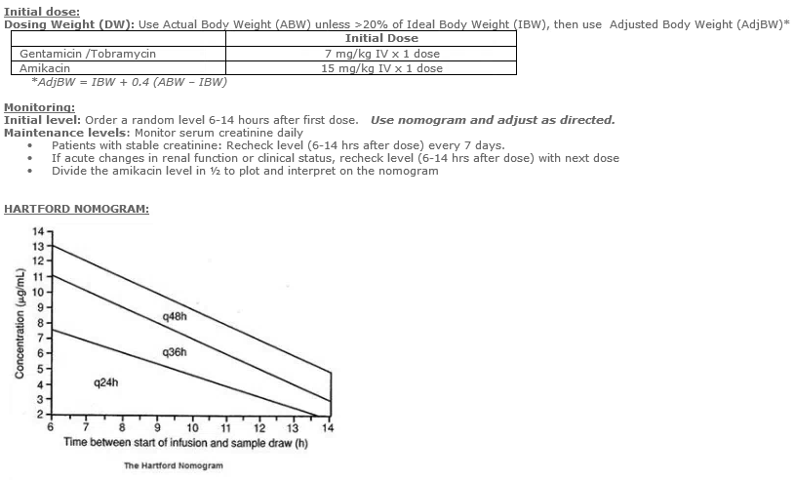
Gentamicin/Tobramycin and Amikacin with Hartford Nomogram

Slide 48
Aminoglycosides vs. quinolones when concerned about PSAE
Benefits of quinolones:
  Less oto and nephrotoxicity
  No need to monitor levels
  Can start or convert to oral therapy
Benefits of aminoglycosides:
  More potent for PSAE by 15-20% - less likely acquired resistance
  Usually broader coverage for healthcare acquired (resistant) organisms

Slide 49
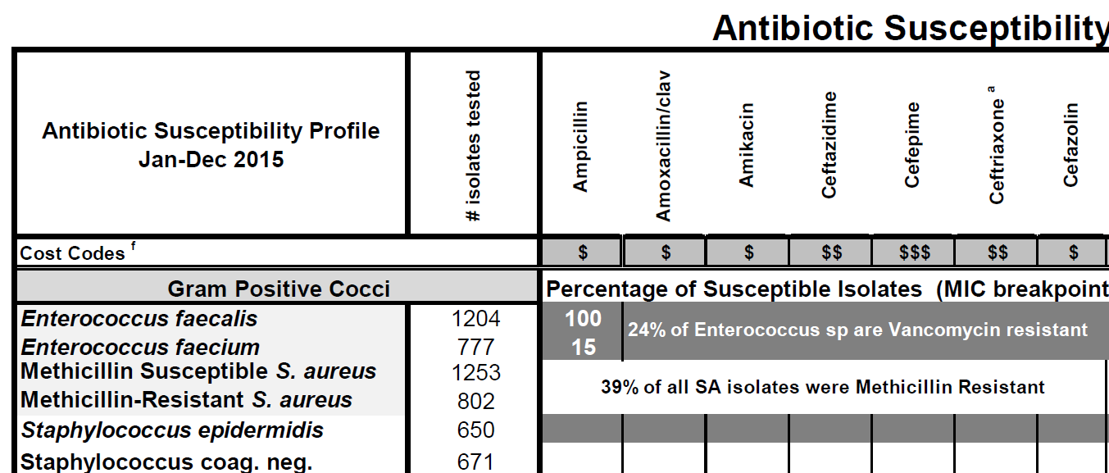
What’s an antibiogram and how can it help?
A Hospital antibiogram is a summary of antimicrobial susceptibilities of local bacterial isolates submitted to the hospital's clinical microbiology laboratory in a given time period
They can be used by clinicians to assess local susceptibility rates, to aid in selecting empiric antibiotic therapy, and to monitor resistance trends

Slide 50
Last case
81-year-old diabetic female presents to her PCP via her daughter with urinary frequency, fever of 101°F x 2 days and confusion
  She appears ill, is tachycardic at 110 BPM and is admitted
  A UA demonstrates pyuria and a serum WBC is 13k
  Blood cultures are drawn, a urine culture is sent
What antibiotic will you start empirically?
Review some steps you would consider in your decision

Slide 51
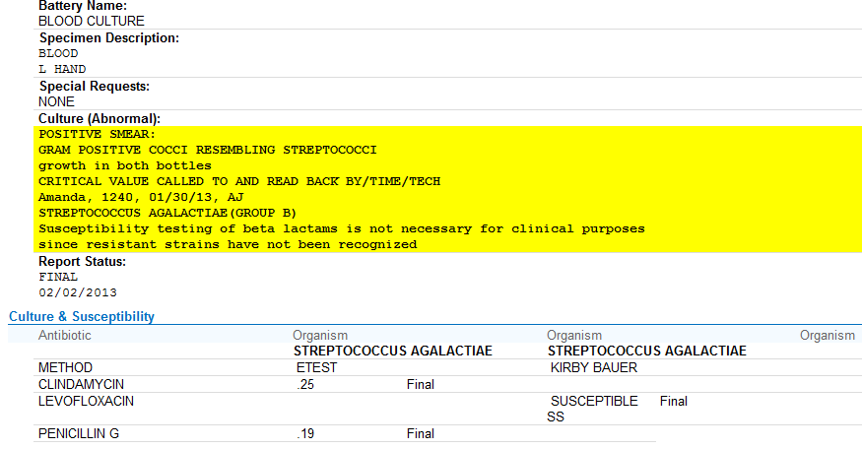
Case 5, culture result
Can we switch to PCN G?

Slide 52
Back to the basics – interpret susceptibility
Kirby bauer: (disk diffusion antibiotic sensitivity testing) uses antibx-impregnated wafers to test whether bacteria are susceptible to specific antibiotics (does not give MIC (S/IS/R)
Etest: provides Minimum Inhibitory Concentrations (MICs) for slow-growing organisms and those not usually tested by automated methods
Minimum Inhibitory Concentrations (MICs): how we usually determine if an organism is “susceptible” to an antibiotic (micro broth dilution)
  Mix standard concentration of organism with increasing antibiotic concentration in a test tube or on a plate

Slide 53
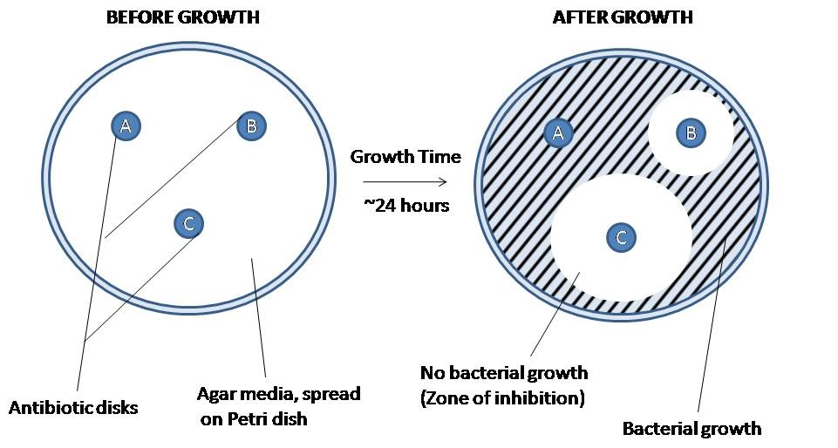
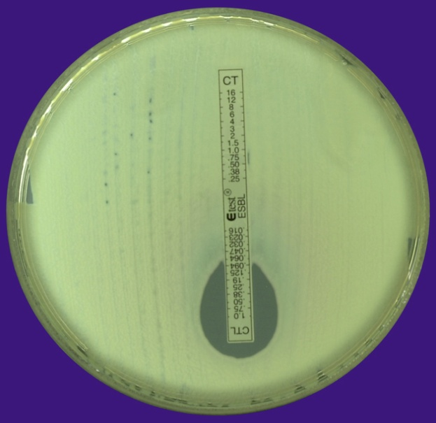
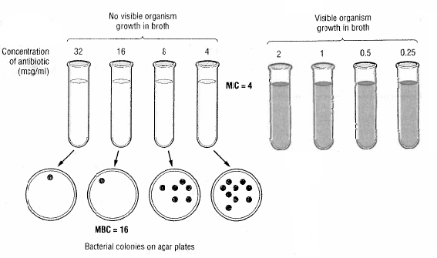
Ways to Determine Susceptibility
E test = Measure here
Disc diffusion method
Best method = MIC

Slide 54
Case follow-up
Blood cultures starting hospital day 3 are negative
After volume resuscitation and on day 4 of hospitalization her delirium is significantly improved
MIC
PCN G | <0.12 | highly susceptible
(S. agalactiae MIC = 0.19) | 0.12-0.5 | intermediate
 | >0.5 | resistant

Slide 55
Summary
Recognition: does the patient need an antibiotic?
How do we choose?
  Consider spectrum, tissue penetration, resistance, safety, bacteriocidal vs. static
Common antibiotic classes
  Keep in mind coverage for common classes: penicillins, cephalosporins, aminoglycosides, quinolones
Understand how to interpret susceptibility (don’t forget to keep in context of the clinical case)

Slide 56
Individual Readiness Assessment Test
  How would you treat a mild non-purulent cellulitis of the left leg?
  How would you treat a moderately severe purulent cellulitis and associated abscess of the thigh.
  A patient is admitted with community-acquired pneumonia to a floor bed. What pathogens are you presumably covering for?
  What empiric antibiotic coverage do you recommend for a patient with new VAP in the ICU?
  What nomogram can you use to help you dose aminoglycosides?
  What general class of pathogen(s) coverage is aztreonam missing?
  If you are using cefepime and vancomycin for a patient hospitalized for > 48 hours with new HAP, what coverage should you add if aspiration becomes a concern?
  What is an MIC?
Penicillin, cephalexin, dicloxacillin or clindamycin
Vancomycin, daptomycin, linezolid, telavancin or ceftaroline
S. pneumoniae, legionella, mycoplasma, chlamydia
Cefepime or Pip/tazo or meropenem/imipenem + vancomycin or linezolid (+/- an aminoglycoside if there is high % PSAE resistance to your primary GN choice of therapy)
Hartford
Gram-positive and anaerobe
Anaerobe (need clindamycin or metronidazole)
Method of determining if an organism is “susceptible” to an antibiotic. You mix a standard concentration of organism with increasing antibiotic concentration in a test tube. MIC = the level with no visible growth.

