Slide 1
Tuberculosis
Infectious Diseases Elective

Slide 2
Outline
Epidemiology
Pathogenesis
Immunology
Latent TB detection - IGRA and TST
Latent TB treatment
Pulmonary TB
Diagnosis
Treatment
Extrapulmonary TB
Prevention

Slide 3
Epidemiology
#1 infectious cause of death worldwide (second to COVID-19)
Estimated in 2021 2 billion people worldwide are infected with M. tuberculosis
  5-10% will develop active disease in their lifetime
    Risk higher in those who have HIV/immunocompromising conditions, undernutrition, DM, ETOH use and smoking
  After introduction of COVID-19 dramatic drop in case notifications of new diagnosis of TB in compared to increasing rates 2017-19 (with increased deaths in 2020)
  Multi-drug resistant TB (4% of new diagnoses; 20% of those previously treated)
    >50% in countries of the former Soviet Union
WHO 2021 Global TB Report: http://www.who.int/tb/publications/global_report/en/

Slide 4
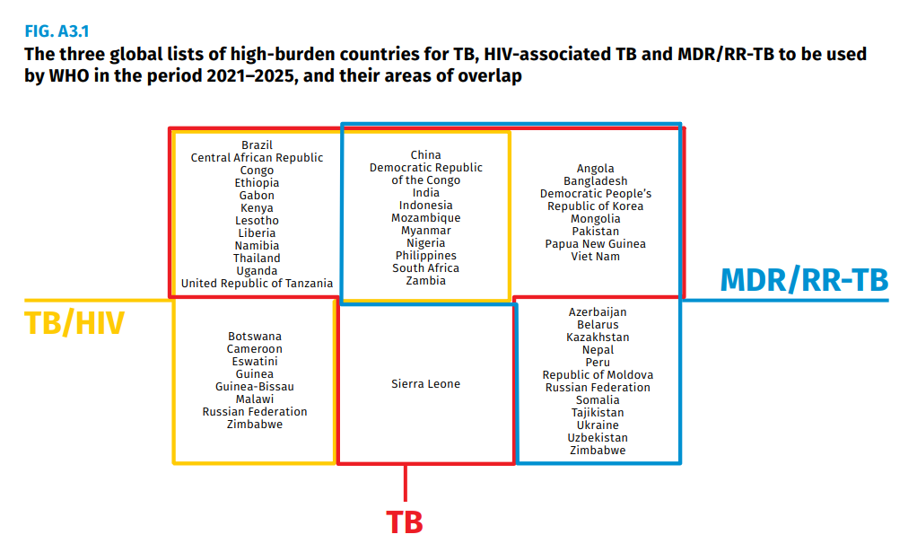
WHO 2021 Global TB Report: http://www.who.int/tb/publications/global_report/en/

Slide 5
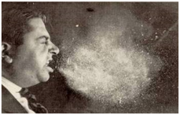
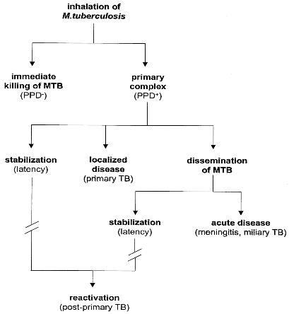
Transmission and basic pathogenesis
Patients most likely to be exposed to TB: healthcare employees, homeless, imprisoned, nursing home patients, emigration from endemic country
Patients most likely to develop active TB: immune compromising condition (i.e. HIV, malignancy, DM, CKD, IVDA, malnutrition, on immunosuppressants)
90%
10%
80% in US
https://www.cdc.gov/tb/topic/basics/risk.htm

Slide 6
Contain multiple bacilli
Macrophages ingest bacilli
May eliminate small numbers of bacilli
Cellular immunity develops (usually)
TST/IGRA +, only evidence of infection in most
Reach terminal airspaces and multiply
Sub-pleural
Multiplication destroys macrophages
Less common: pulmonary focus/regional lymph nodes necrosis and calcification
Rare: Tiny foci of viable bacilli persist
Inhalation of droplet
Lower parts of upper lobes/upper parts of lower/middle lobes
Children, elderly, HIV-> primary focus may spread/ disseminate
Lymph nodes, kidneys, long bone epiphyses, vertebral bodies, meninges, apical-posterior lungs

Slide 7
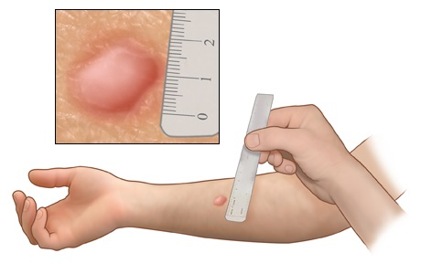
IGRA and TST – cellular immunity
TST (tuberculin skin test) | IGRA (interferon gamma release assay)
No lab infrastructure, cheap | Costly, lab infrastructure, phlebotomy expertise, processing etc.
High personnel time requirement, inter-reader variability | Standard process, still technical variability, frequent conversions
2 visits | 1 visit
False negative with immune suppression, extremes of age | False negative with immune suppression
False + with BCG, NTM | No BCG false +, less NTM false +
NTM that cross-react with IGRAS:
M. kansasii, marinum, szulgai, flavescens
These tests are designed for latent TB detection
IGRAs ~50-80% sensitive for active TB
Routine use of both not recommended
TST size (mm) | Conditions
<5 | HIV infection + close contact
5-10 | HIV, close contact, abnormal CXR c/w old TB, immunosuppression (TNF, chemo, organ transplant, steroids)
10-15 | Kids <4, Foreign born (incidence > 25/100K), employees in high-risk settings, high risk chronic disease (HD, silicosis, DM, leukemia, lymphoma, lung CA, head/neck CA, underweight, jejunoileal bypass, IVDU
Dewan PK, et al, Clin Infect Dis. 2007; 44(1): 69. Sester M, et al. Eur Respir J. 2011; 37(1): 100. Metcalfe JZ, et al. J Infect Dis. 2011; 204(S4): S1120.
http://www.newhealthadvisor.com/What-Does-a-Positive-TB-Test-Look-Like.html

Slide 8
Latent TB
Latent TB = not symptomatic and not contagious; active TB = very contagious
+IGRA/TST + normal chest imaging + asymptomatic = latent TB
Goal: identify those with exposure and non-active (latent TB) at risk of reactivating/transmitting disease; 1/10 people with latent TB → active TB
Risk for reactivation: exposure to active TB, IVDA, homelessness, imprisoned, nursing home, health care workers, immunosuppression therapy, HIV
Decision to test for latent TB = decision to treat latent TB

Slide 9
Latent TB Treatment
Treat to:
  Reduce likelihood of progression
    60-90% overall risk reduction
  Reduce transmission risk (via #1)
Regimens:
  Daily Rifampin x 4 months
  Weekly INH + Vit B6 + Rifapentine x 3 months
  Daily INH + Vit B6 + Rifampin x 3 months
  INH x 6 or 9 months + Vitamin B6 (↓neuropathy)
Preferred
Alternate

Slide 10
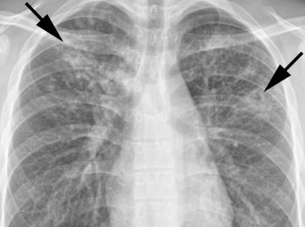
Chronic (classic) Pulmonary TB
Pneumonitis -> inflammatory response in a sensitized host leads to alveolar exudate/infiltrates
Waxing and waning radiographic findings
Caseous necrosis surrounded by epithelioid cells, granulation tissue and eventually fibrosis
Can become encapsulated and heal but caseation tends to liquify and drain into the bronchial tree -> additional lung foci develop
Bacillary multiplication in the cavity
Asymmetrical
Upper lobe (lower if HIV)
Caseation
Fibrosis
Cavitation
Calcified nearby lymph node: Ghon complex

Slide 11
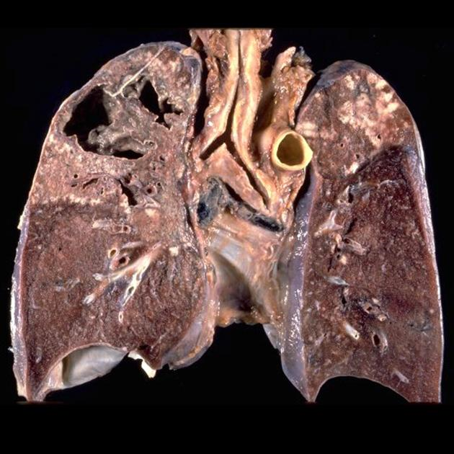
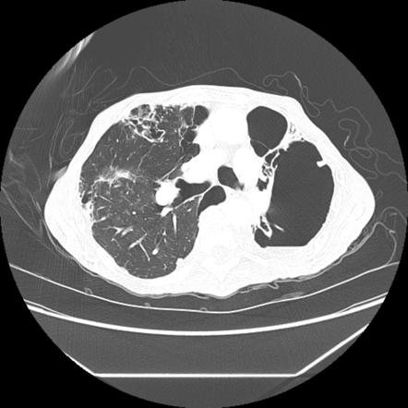

Slide 12
Chronic Pulmonary TB
Symptoms
  Occasionally brief symptoms with initial infection
  Months/years: cough, weight loss, fevers/chills/night sweats, anorexia, chest pain, malaise
  Hemoptysis usually indicates more advanced disease
AIDS
  Lower lobes
  Absence of cavitation
  Higher incidence of extrapulmonary TB
  Negative TST/IGRA
  Less hilar/mediastinal adenopathy
  Less advanced HIV: TB similar to HIV negative

Slide 13
Diagnosis of pulmonary TB
AFB Smear
  ~60% sensitive
    Less in non-cavitary disease, HIV
    Sensitivity improves by subsequent samples
  Simple, fast, cheap
Culture
  Usually solid + liquid cx done.
  Solid media: (LJ (egg) or Middlebrook (agar), growth in 3-8 weeks
  Liquid media: automated systems, 2-3 weeks, similar sensitivity but no morphology
  Needed for full drug susceptibility testing
NAAT: Rapid results, expensive, variable drug susceptibility capabilities (can help identify MDR TB)
  Sequence-based testing: can assess for mutations to predict resistance
  Gene Xpert: 3 samples 99.8% sensitive for smear positive, 90.2% for smear negative

Slide 14
Treatment of pulmonary TB
At least 3 sputum samples for smear, culture, Xpert test (if available)
Start standard treatment if TB suspected (RIPE)
If cultures are negative but clinical/radiographic response & no alternative dx -> TB
3 cultures monthly to monitor for conversion or treatment failure
  Can see smear + long after they are culture negative
  Treatment failure = + cultures after 4 months of treatment
    Resistance, compliance, malabsorption
    Repeat sensitivity testing, add 2 drugs
Monthly monitoring for symptoms of hepatitis (labs if symptoms), snellen eye chart/Ishihara Test for Color Blindness/eye exams (ethambutol)
Add B6 (helps with INH-related neuropathy)

Slide 15
Treatment
Standard 4 drug = RIPE
Nahid P, Dorman SE, Alipanah N, et al. Clin Infect Dis, 2016; 63(7): 853-67

Slide 16
Common side effects
INH
Drug interactions!!!
Hepatitis
Pyrazinamide
GI upset
Hepatitis
Ethambutol
Decreased red-green color discrimination
Decreased visual acuity
Rifampin
AST/ALT elevation, hepatitis
Peripheral neuropathy
Rash
Check baseline LFTs, repeat monthly if abnormal, symptoms or risk factors
GI upset
Hyperuricemia
Orange secretions (urine, tears)

Slide 17
Types of Extrapulmonary TB
Miliary TB (millet seeds)/disseminated TB
TB meningitis, CNS tuberculoma
TB pleurisy, empyema and bronchopleural fistula
Pericarditis
TB spondylitis (Pott’s disease)
Peripheral osteoarticular TB
GU TB: Renal, male genital TB, female genital TB
TB lymphadenitis: peripheral (scrofula), mediastinal, mesenteric

Slide 18
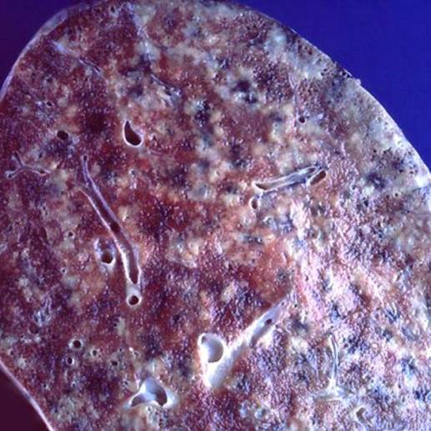
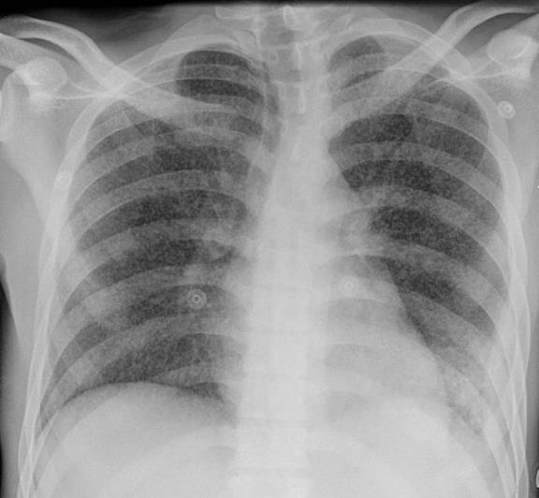
Miliary TB

Slide 19
Miliary TB
HIV (risk for miliary + extrapulm TB)
Acute miliary TB
  With primary infection, often children
  Can occur w/pleural effusion, peritonitis, or meningitis in 2/3
  More chronic and less severe in young adults
Cryptic miliary TB
  Prolonged illness, likely intermittent bloodstream seeding from another site (GU, renal, bone, lymph nodes)
  Older patients can have negative CXR, negative TST. Often diagnosed at autopsy
Non-reactive miliary TB
  Rare, huge numbers of bacilli
  Liver, spleen, marrow, lungs, kidneys – not the meninges
  Overwhelming sepsis

Slide 20
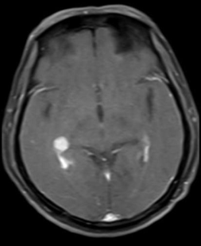
TB meningitis
Usually caused by rupture of a subependymal tubercule rather than hematogenous seeding
Risk in children > adults with military disease
Syndrome: chronic meningitis, most pronounced at brain base
Classic CSF: lymphocytic pleocytosis, hypoglycorrhachia, elevated protein; Early neutrophil predominance, normal to low glucose
Diagnosis is difficult, but improving (Xpert Ultra)
Treatment duration: 12 months, use RIPE + adjunctive steroids
Strokes, neurologic disability in survivors are common
Mortality is high, > 50% in HIV infected patients
Notes:
Also tubeculoma, spinal meningitis

Slide 21
Pericarditis
Contiguous spread > miliary TB
Abrupt or insidious onset
Multi-loculated pericardial effusion suggestive of TB
TST often negative, often presumptive diagnosis in areas with high TB rates
Pericardiocentesis only with hemodynamic compromise
  Constrictive pericarditis, tamponade
  Bloody fluid: cancer or TB
  May need pericardial window
Thoracentesis when possible, ~ 1/3 of cases
Culture, AFB smear, PCR

Slide 22
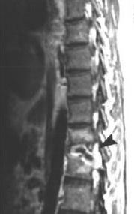
Pott’s Disease
1/3 of skeletal TB involves the spine
Vertebral body -> intervertebral disk -> adjacent vertebra
Lower thoracic > lumbar spine
Low resource settings: teens, young adults
Higher resource settings: elderly
Often no other sign of TB
Can spread to adjacent areas
Diagnosis: sparse bacilli, culture + in ½ of cases, histology in ¾
6-9 months of therapy, surgery often not needed unless poor response, cord compression, spinal instability

Slide 23
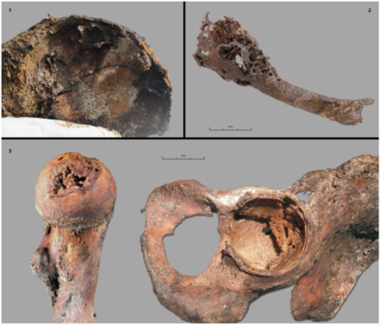
Peripheral osteoarticular TB
Historically: peripheral monoarthritis of the hip/knee, chronic, slowly progressive, without additional signs of TB
More recently: elderly, more systemic symptoms, multiple joints, periarticular abscesses
Pain, radiographic changes, cold abscess, draining sinus tracts
Diagnosis: biopsy, smear, culture, histology

Slide 24
GU system disease
Renal TB
  Frequent, asymptomatic foci with other primary TB infections
  May have had initial TB infection decades prior
  Sterile pyuria is classic, diagnostic delay can occur with bacteriuria
Female genital TB
  May resemble cervical cancer, endometrial cancer, PID that isn’t responding to treatment
  Infertility, menstrual disorders, abdominal pain
Male genital TB
  80% with co-existing renal disease. Epididymitis, orchitis, prostatitis, sinus tracts. Calcification can help with diagnosis. Surgery often prior to ID of disease
Surgery may not be needed for treatment but may be for diagnosis

Slide 25
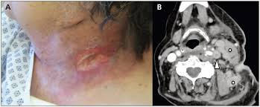
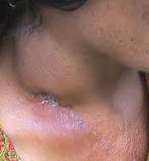
Peripheral TB Lymphadenitis (Scrofula)
Most frequent extra-pulmonary TB
HIV negative – usually unilateral, cervical
  Concurrent with primary infection in kids but usually not secondary sites or systemic symptoms in adults
  FNA: granuloma, often negative smear/cx
  Usually need excisional biopsy with cx.
  Drain placement -> fistula
  25% of cases get pain, enlargement, sinus tract, new nodes that does not indicate failure. Reaction to remaining antigen
HIV infected – multifocal, major systemic symptoms
  Often positive AFB stain on FNA
    More bacilli

Slide 26
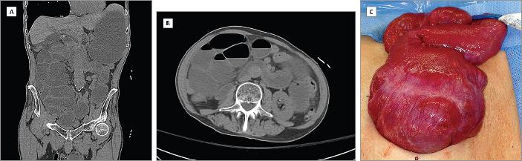
Fibrotic disease
Cocoon abdomen
Fibrosing mediastinitis
  More rare than histoplasmosis
  Due to compression of pulmonary veins and arteries or SVC
  Rarely any active disease
  Diagnosis via thoracotomy, mediastinoscopy usually contraindicated or unsuccessful
  Treatment is supportive, sometimes palliative surgeries are done with variable outcomes
Fibrosis peritonitis
  Rare
  Multiple series’ from India
  Treatment is supportive as with fibrosing mediastinitis
  ‘Cocoon abdomen”
https://jamanetwork.com/journals/jamasurgery/fullarticle/1900898

Slide 27
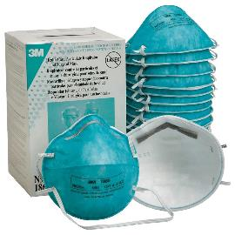
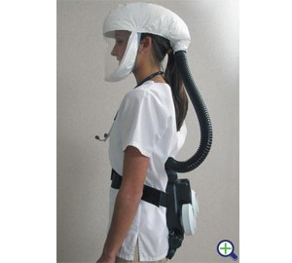
Prevention
In health care: testing & treating for latent TB
Isolation measures (airborne isolation – negative pressure rooms), use of N95 mask (95% filtering capacity) or PAPR (powered, air-purifying respirator)
Prompt treatment of suspected/proven cases
In active cases – continuing isolation until:
    On adequate treatment > 2 weeks
    Improvement of symptoms
    3 consecutive negative AFB smears collected > 8 hrs apart with at least one of those an early AM specimen
BCG is used in endemic countries (not US) to help prevent disseminated TB and meningitis in children

Slide 28
Summary
#1 infectious cause of death worldwide (2nd to COVID-19 during pandemic)
Millions infected annually
Pulmonary and extrapulmonary disease
  Symptoms/signs depend on involved organs
Focus on rapid diagnosis to improve outcomes
Therapies -traditional pulmonary regimens & adaptations to extrapumonary disease
Corticosteroids: pericarditis, TB meningitis
Focus on new pulmonary regimens has been to decrease length, thus far not successful
Prevention is key

Slide 29
Individual Readiness Assessment Test
80%
Healthcare workers, homeless, incarcerated
Upper lobe->leads to cavitation
5-10 mm
No, they have latent TB
Drug interactions, hepatitis, GI upset, orange body fluids
95%
Spine “Pott’s disease”
  Approximately how much of diagnosed TB is reactivated disease?
  List 3 risk factors for exposure to TB?
  Which part of the lung does tuberculosis favor?
  What measurement defines a +PPD in a patient on chemotherapy?
  Is a patient with a positive Tspot with no symptoms contagious?
  Name 3 side effects of rifampin?
  How sensitive is a nucleic acid (NAAT) test in an AFB smear + sample?
  1/3 of skeletal TB involves what anatomic region?

